Slide 1
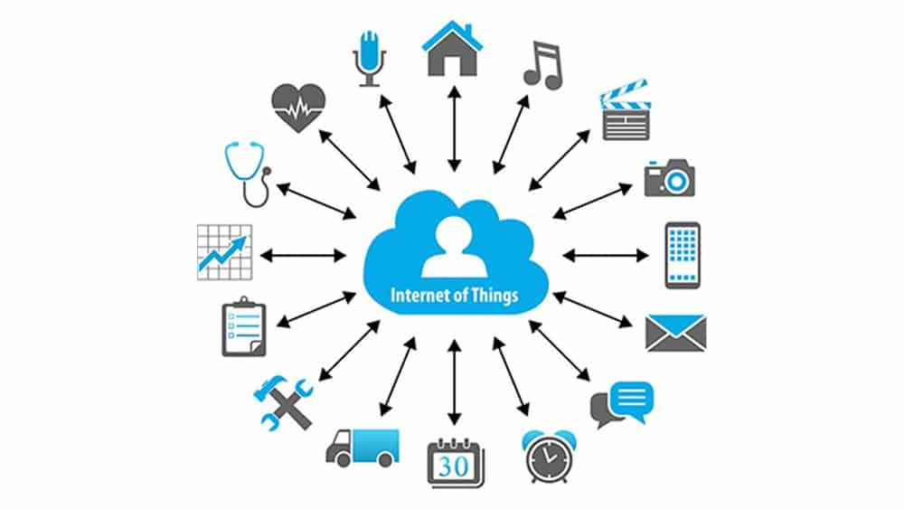
CS8081
INTERNET OF THINGS

Slide 2
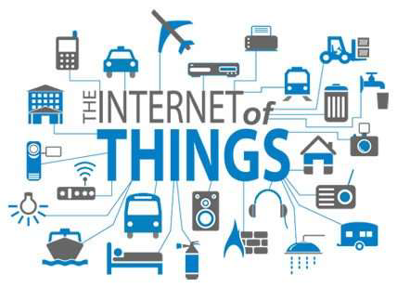

Slide 3
INTERNET OF THINGS
UNIT I
FUNDAMENTALS OF IoT
Evolution of Internet of Things - Enabling Technologies – IoT Architectures: oneM2M, IoT World Forum (IoTWF) and Alternative IoT models – Simplified IoT Architecture and Core IoT Functional Stack -– Fog, Edge and Cloud in IoT – Functional blocks of an IoT ecosystem – Sensors, Actuators, Smart Objects and Connecting Smart Objects

Slide 4
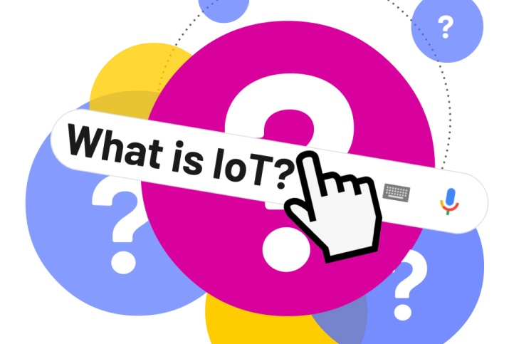
What is IoT?
The Internet of Things (IoT) is the network of
physical objects or "things" embedded with electronics, software, sensors, and network connectivity, which enables these objects to collect and exchange data.

Slide 5
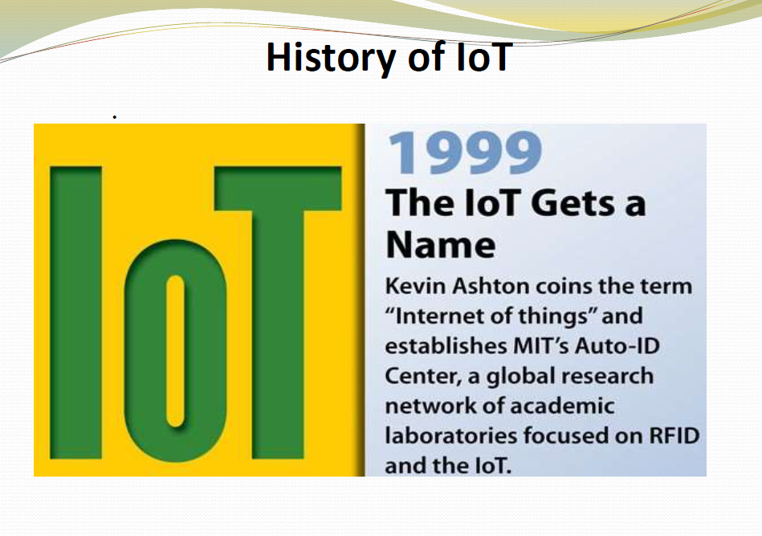

Slide 6
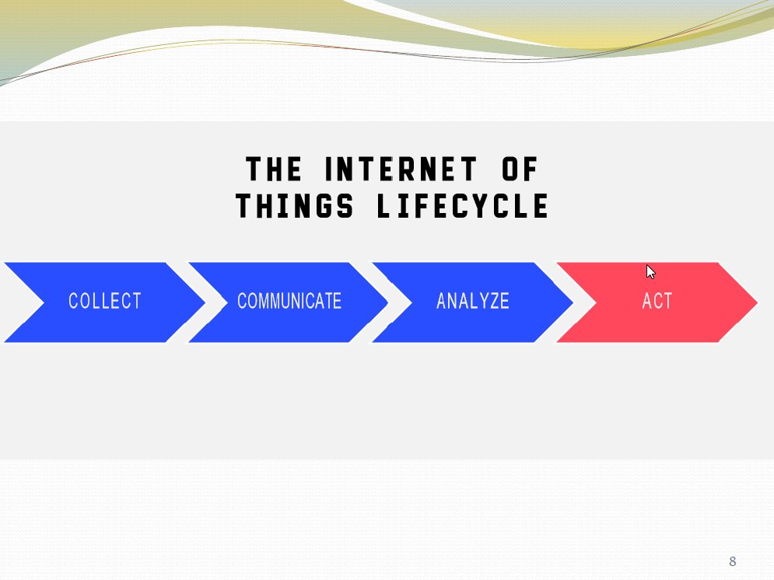

Slide 7
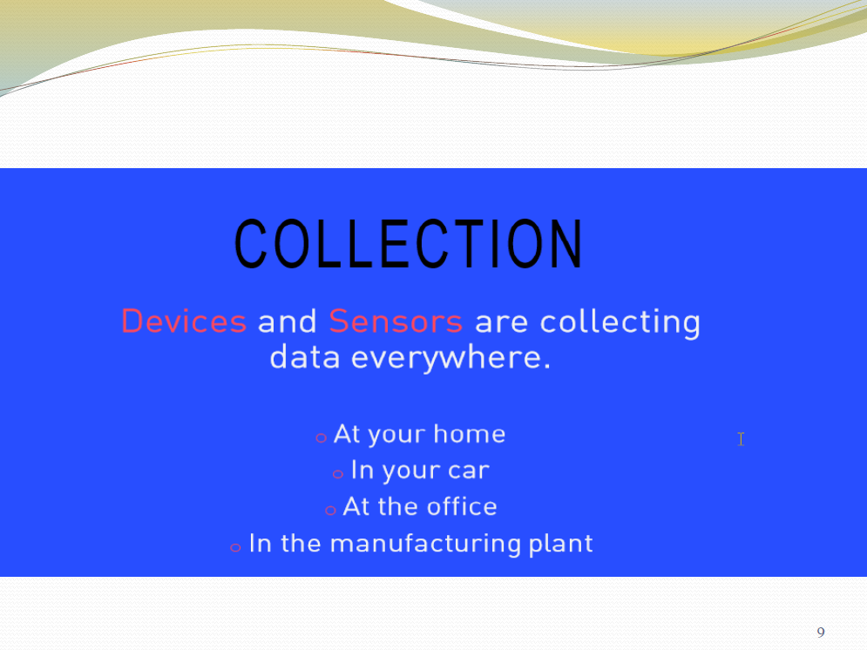

Slide 8
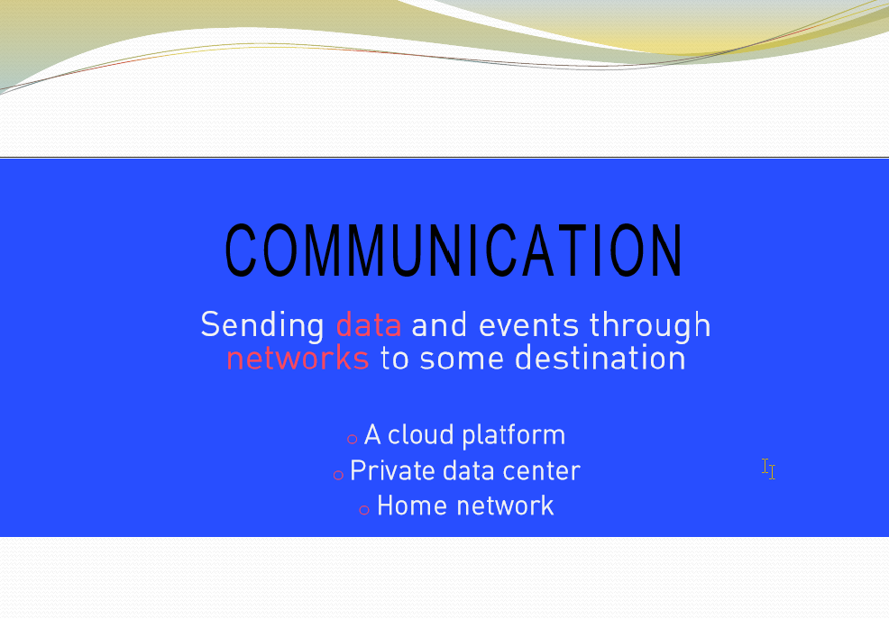

Slide 9
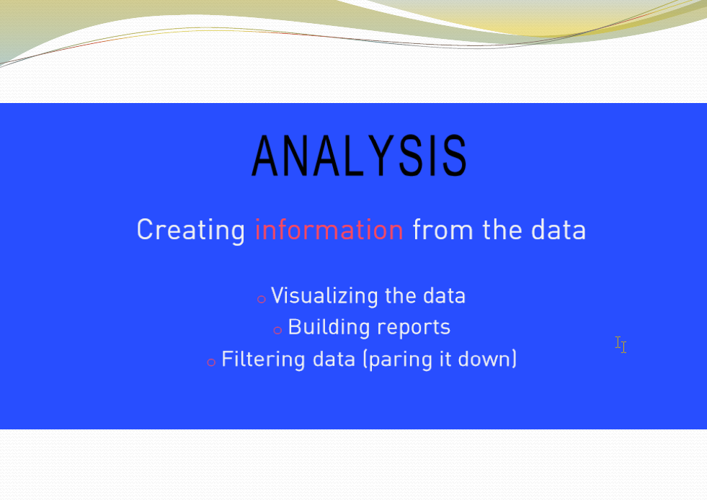

Slide 10
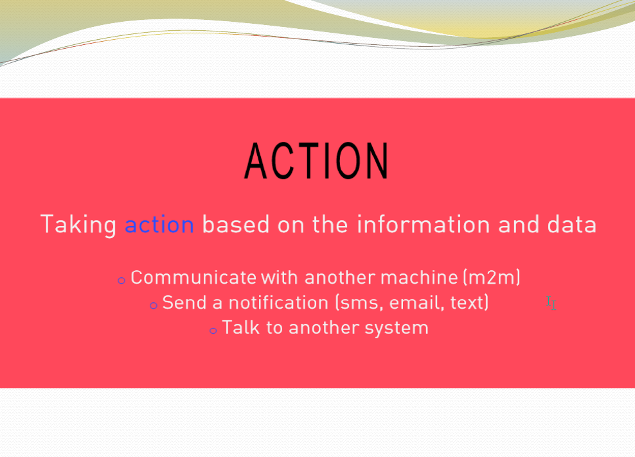

Slide 11
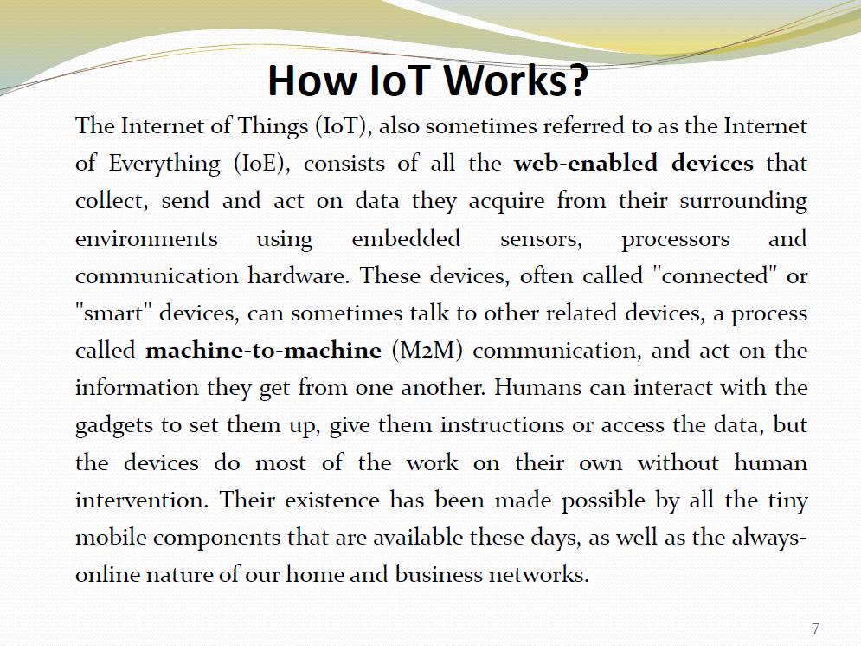

Slide 12
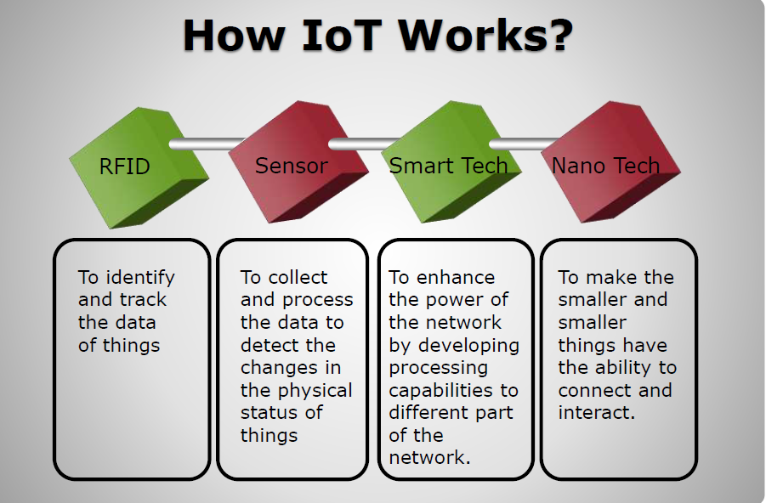

Slide 13
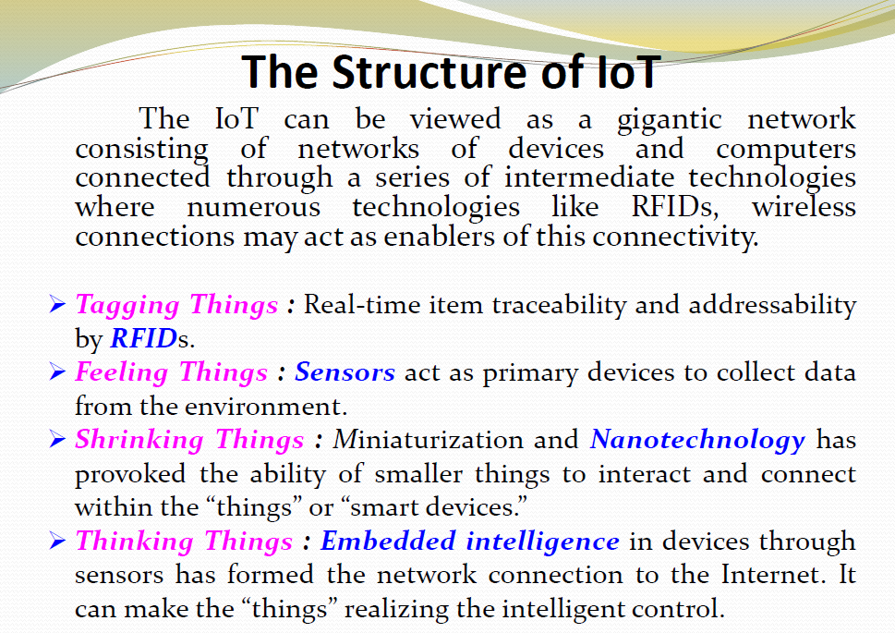

Slide 14
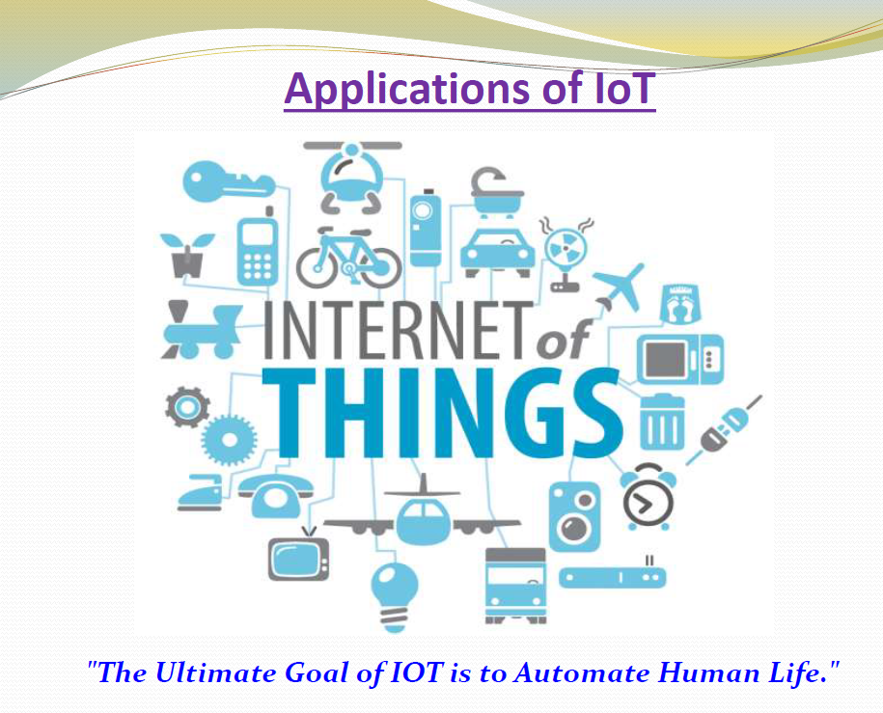

Slide 15
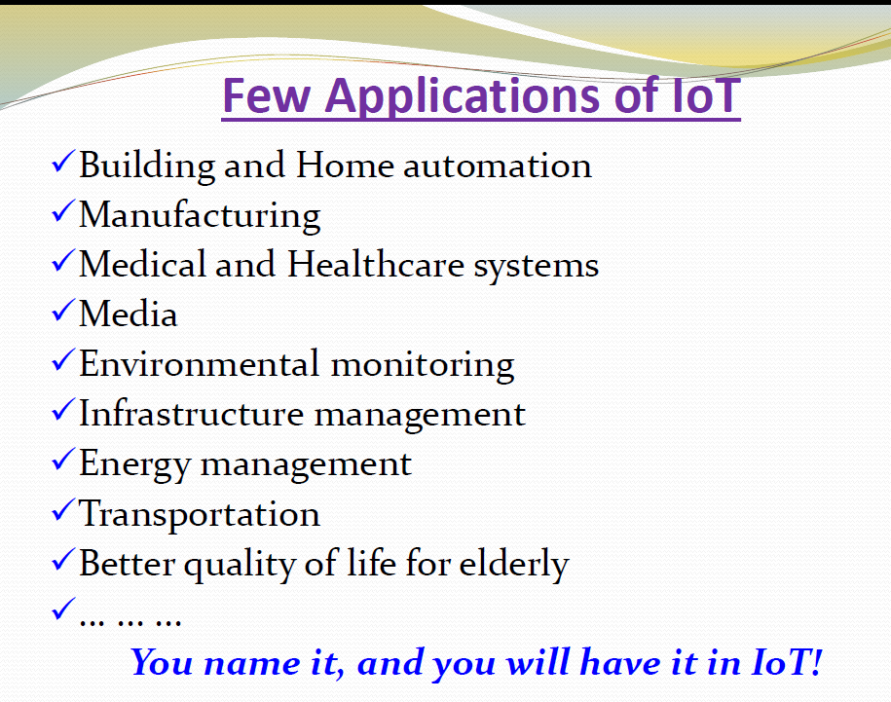

Slide 16
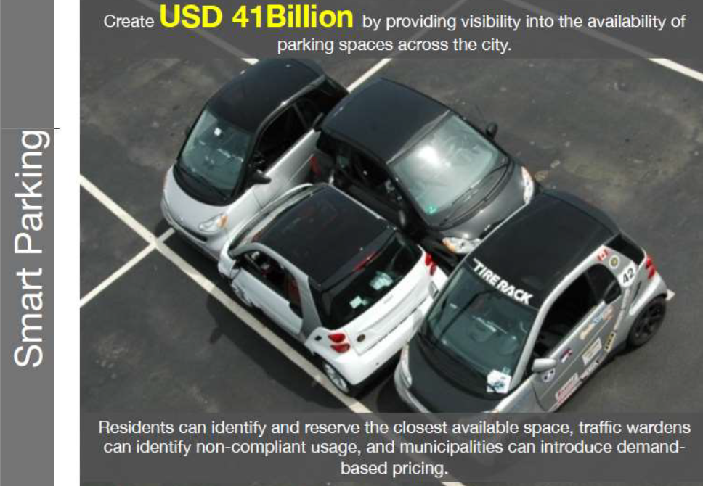

Slide 17
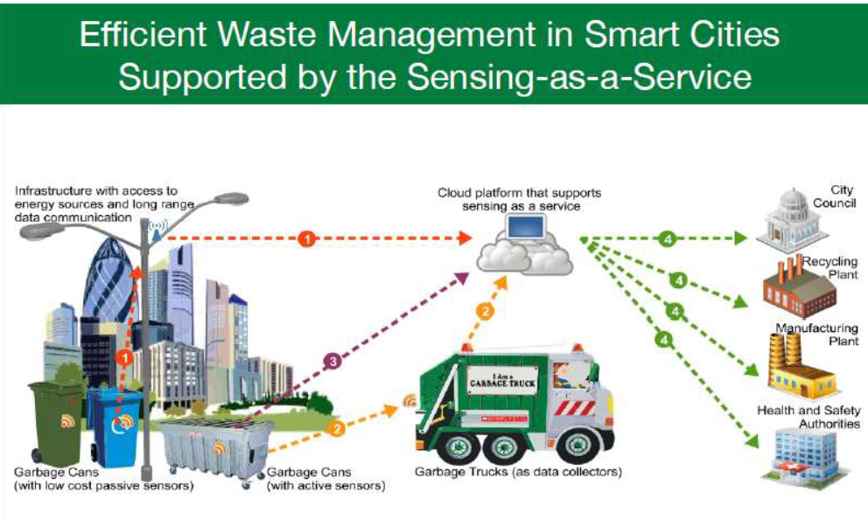

Slide 18
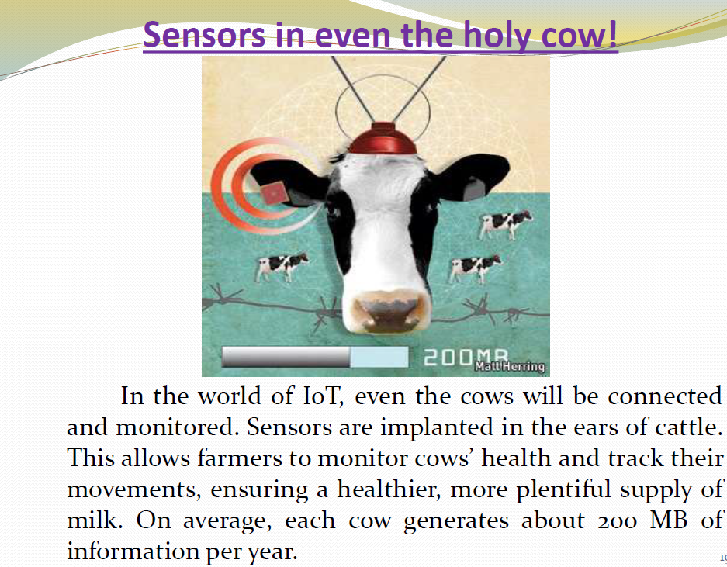

Slide 19
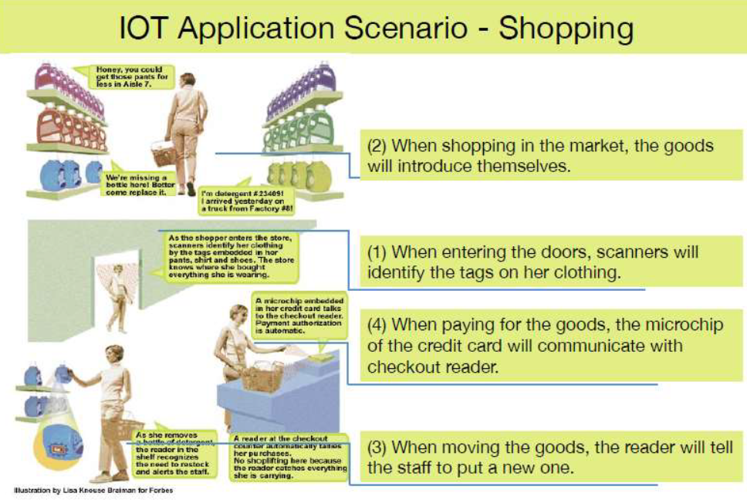

Slide 20
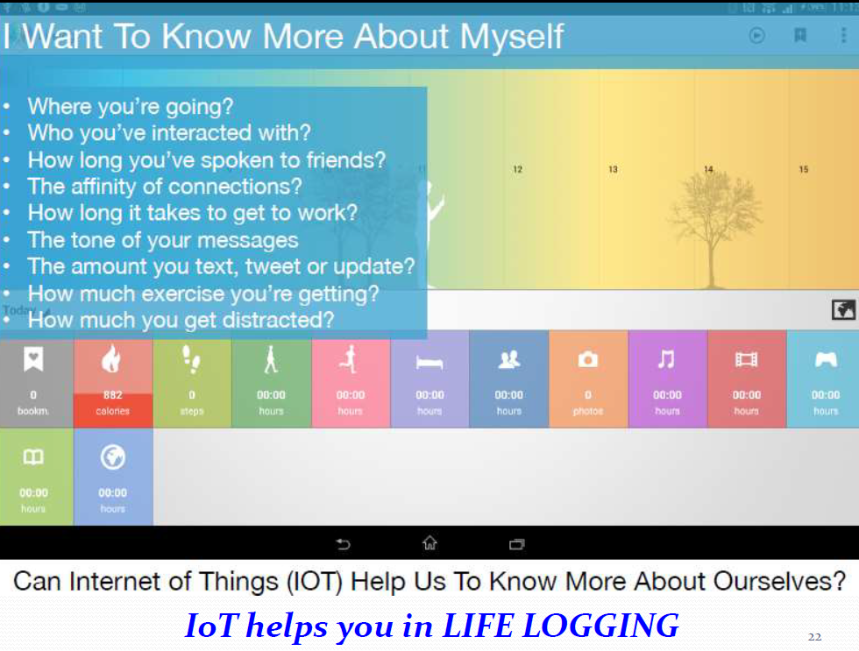

Slide 21
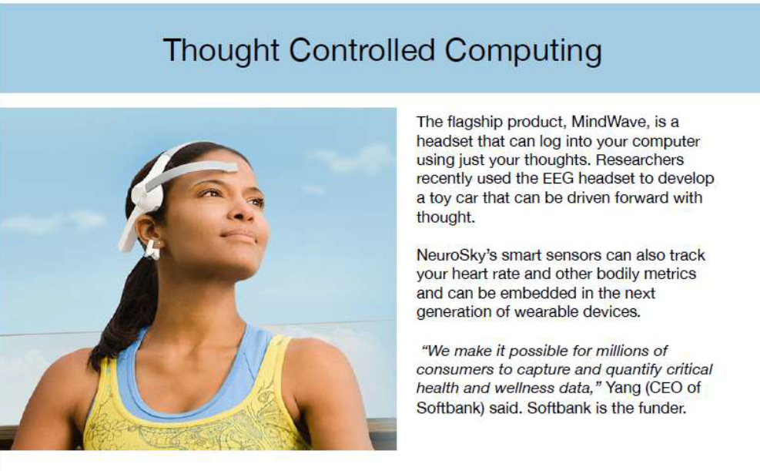

Slide 22
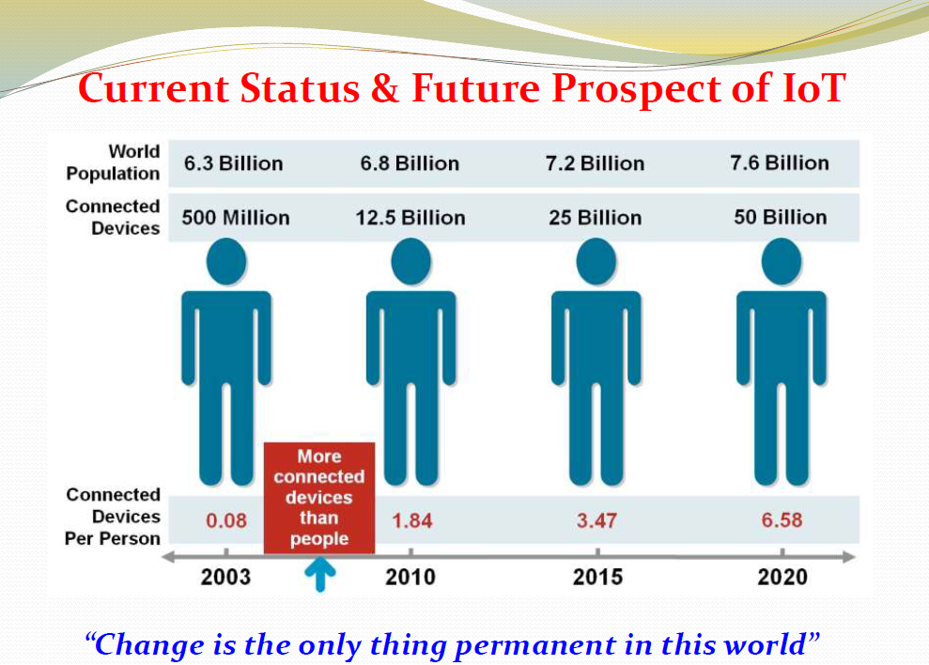

Slide 23
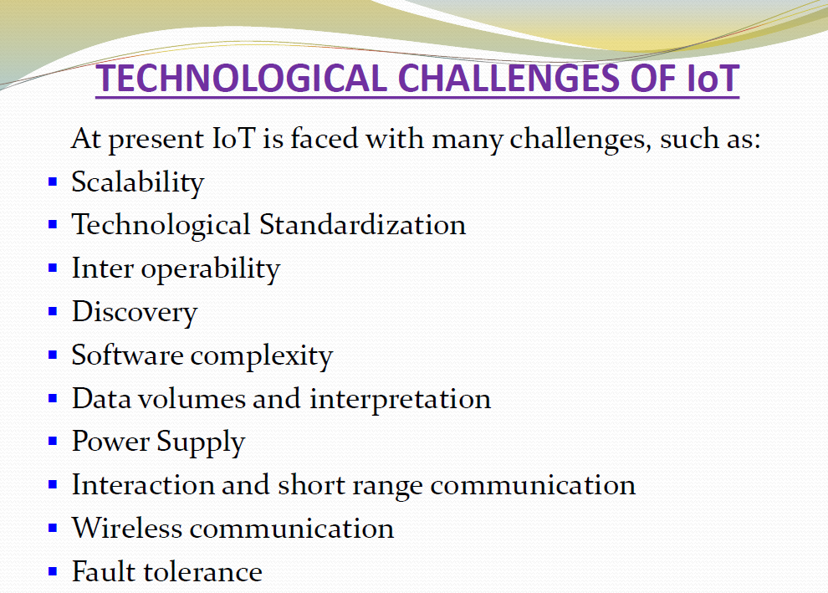

Slide 24
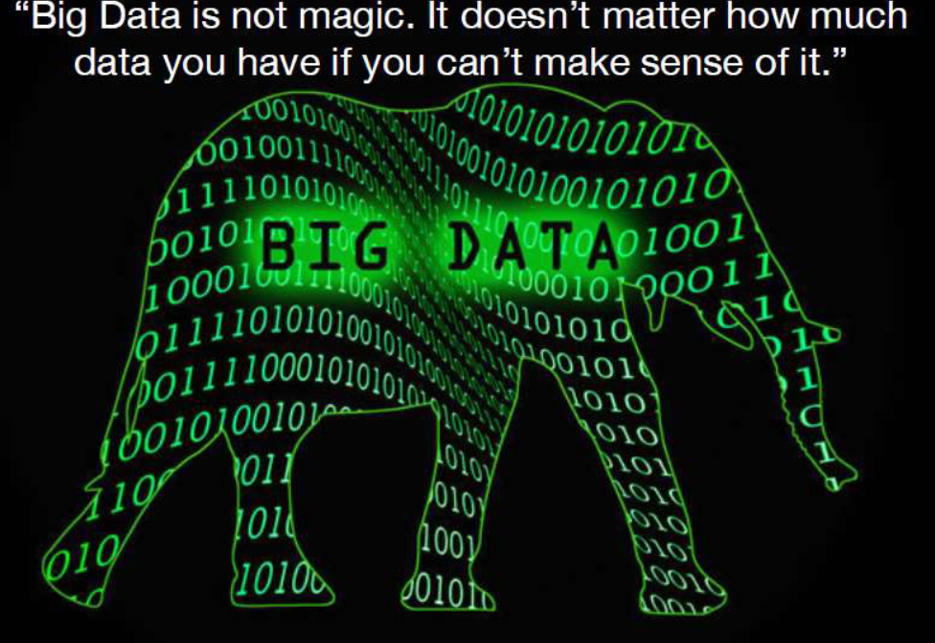

Slide 25
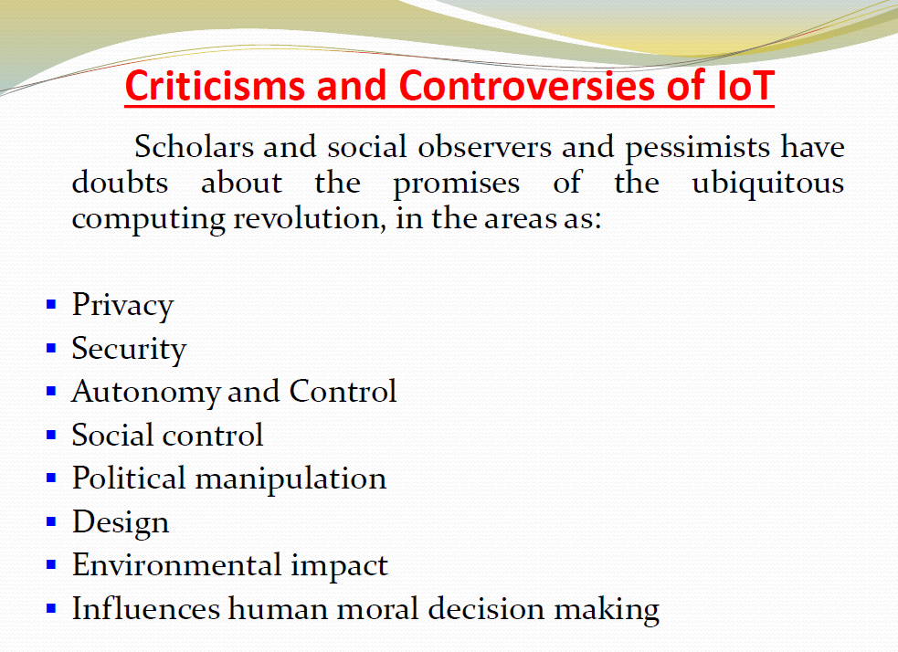

Slide 26
TOP IoT APPLICATION AREAS (Brainstorming Topics)
Smart cities - (1-5)
Smart Environment - (6-10)
Smart Water - (11-15)
Smart Metering -(16-20)
Security & Emergencies -(21-25)
Smart Retail -( 26-30)
Logistics -(31-35)
Industrial Control -(36-40)
Smart Agriculture -(41-45)
Smart Animal Farming - (46-50)
Domestic & Home Automation (50-55)

Slide 27
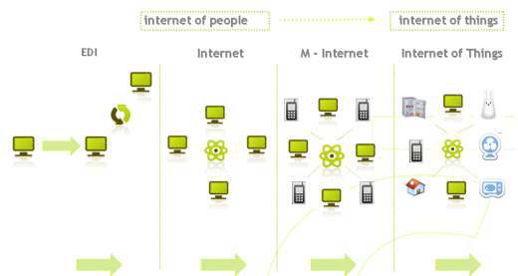
The Evolution of Internet of Things

Slide 28
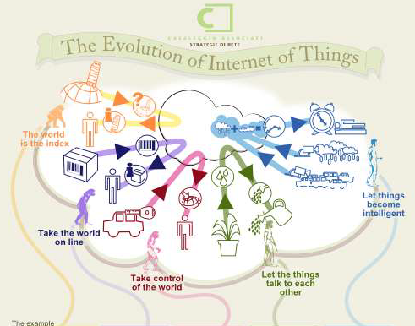

Slide 29
The world is the index
The world is the index that we will use to classify and identify the things that surround us.
For example, the photos that we take have ever more frequently the location of the photographer and the photos can be organised according to location using Google Earth14.

Slide 30
Take the world on line
The things that are surrounding us can have an information shadow on the Internet.
The RFID tags, devices that contain chips that can be read by nearby sensors,
for example the Championchip
Domestic animals can wear RFID collars that are recognized by doors that can open to let them enter.

Slide 31
Take control of the world
The world around us can talk to us and tell us its needs.
To monitor any object connected to the Internet there’s a platform called Pachube that makes it possible for sensors connected to the Internet to send data about themselves and make them viewable in different ways that can be over time and according to place, but above all to trigger actions when certain values are reached (for example, to open a window when a certain temperature is reached).

Slide 32
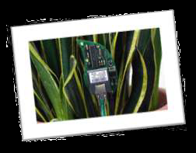
Let the things talk to each other
Objects can interact with each other to exchange and integrate data, to trigger actions and to integrate how they work together.
Even plants can signal their needs. In fact,with Botanicalls, plants can communicate on Twitter when they need watering and the communication can go to a sprinkler system connected to the Internet.

Slide 33
Nike has created “Nike Human Race u” a worldwide race that everyone can take part in by making use of a Nike+ sensor in your shoes no matter where in the world you are. The only constant for all participants is the distance.

Slide 34
Let things become intelligent
Object Generated Content (OGC), that is the creation of knowledge and aggregated value by individual objects, will be of certain orders of magnitude greater than any value that can be created directly by people.

Slide 35
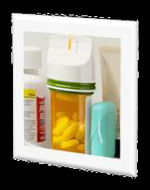
GlowCap44 provides intelligence to medicine bottles. They use light or sound signals or a telephone call to remind you when they have to be taken and they send your doctor or your family a monthly report on what medicine has been taken

Slide 36
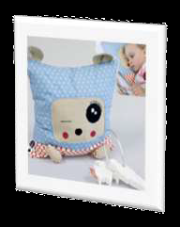
Pling Plong -
is a cushion that
reads books that are
brought close to it.
(Bed time stories)

Slide 37
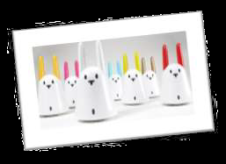
Nabaztag, is a 'rabbit’ connected to the Internet and it reads newspapers, emails, weather forecasts, messages and even audio books downloaded from the Internet.

Slide 38
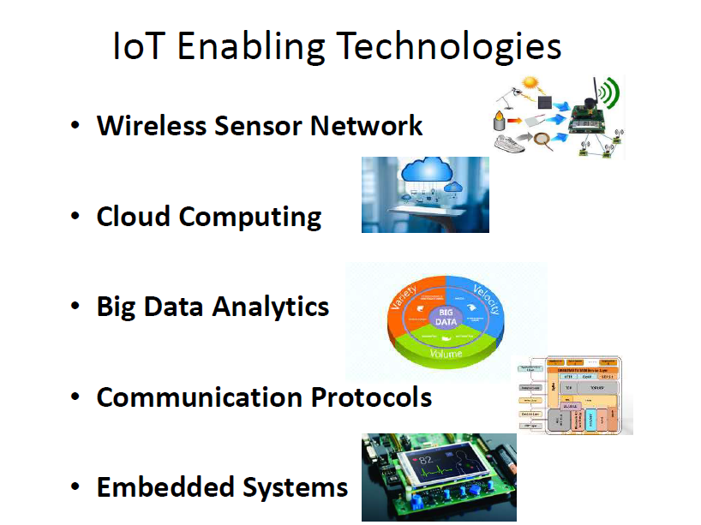

Slide 39
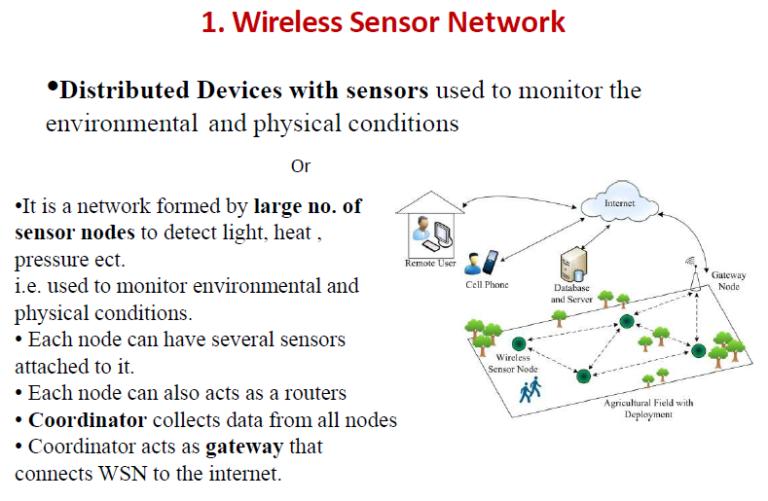

Slide 40
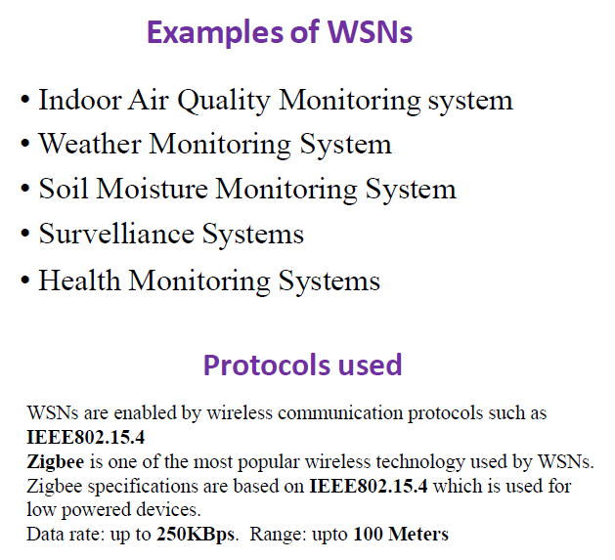

Slide 41
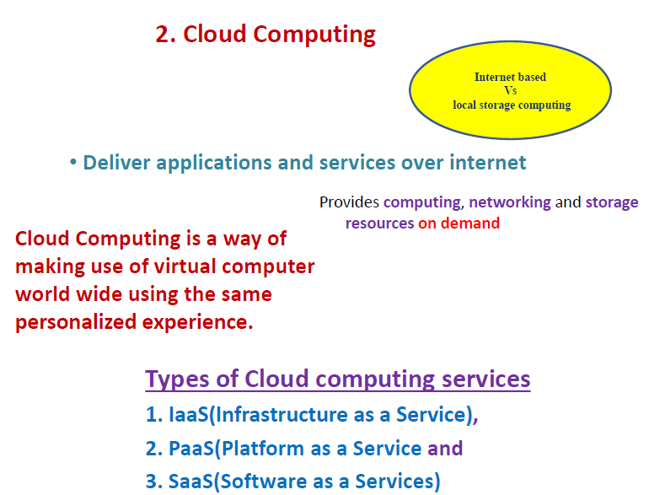

Slide 42
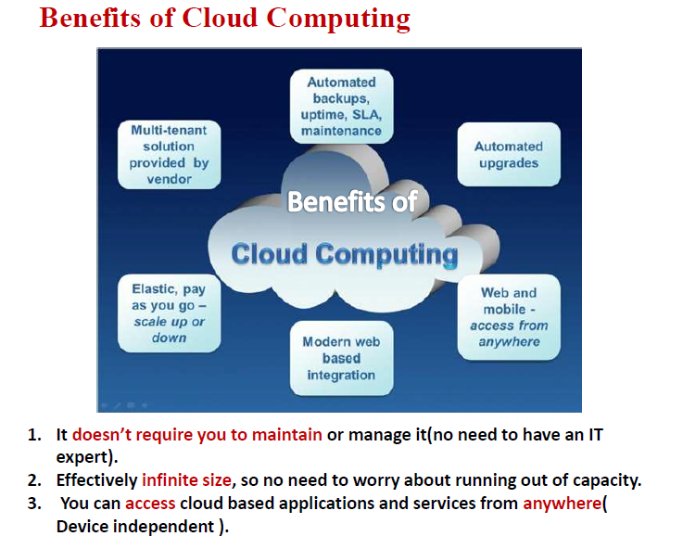

Slide 43
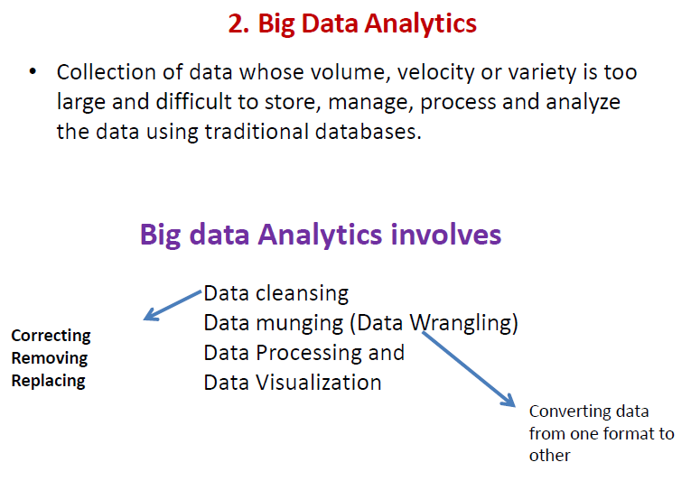
3.

Slide 44
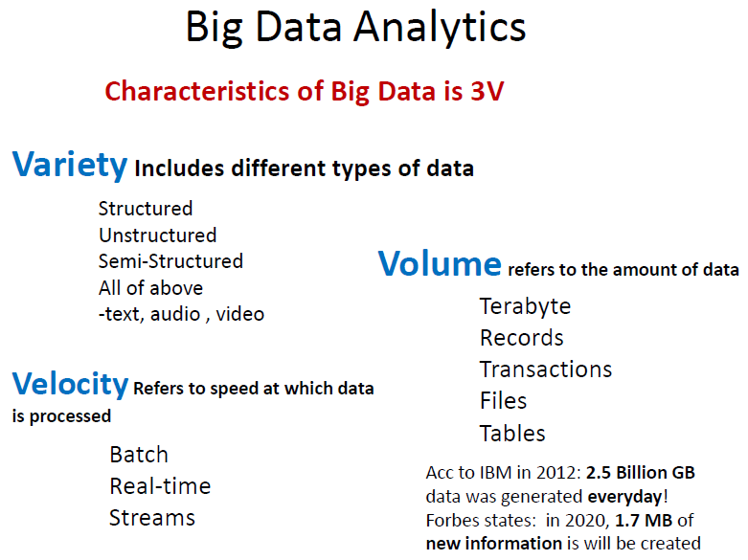

Slide 45
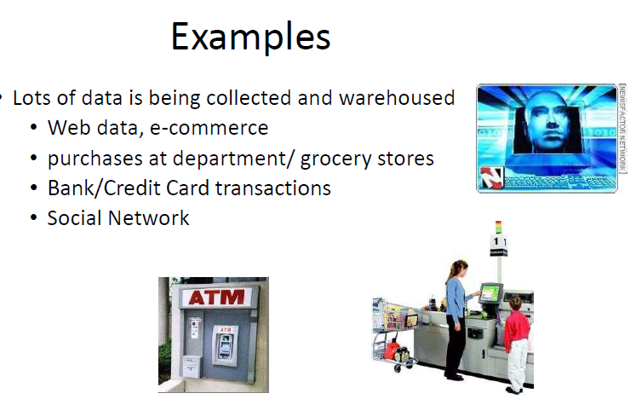

Slide 46
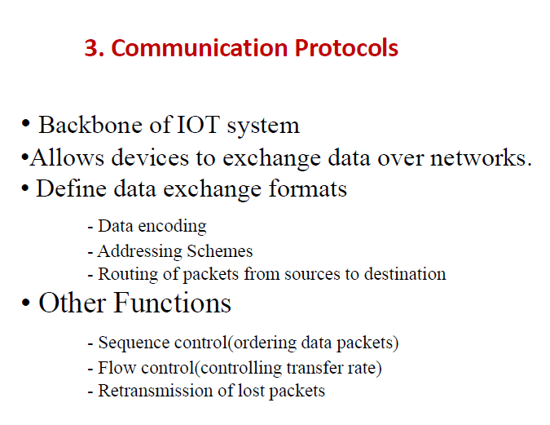

Slide 47
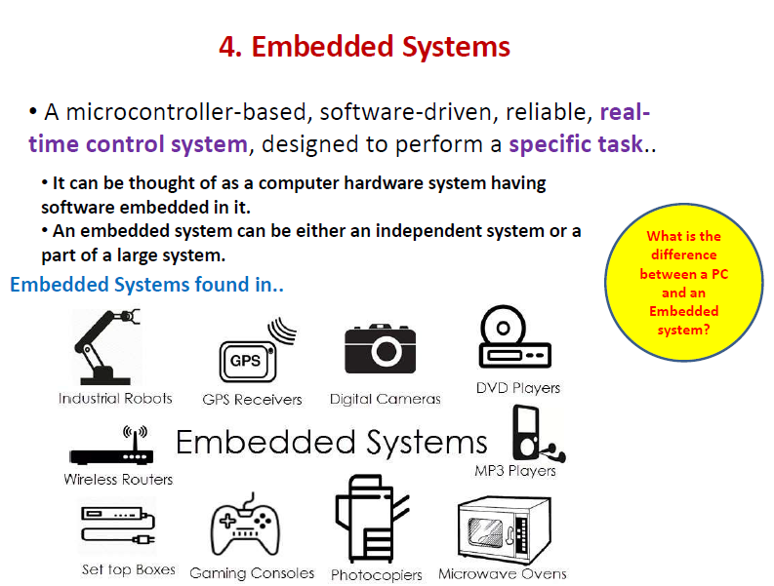

Slide 48
The oneM2M IoT Standardized Architecture
To standardize the rapidly growing field of machine-to-machine (M2M) communications
Common architecture that would help accelerate the adoption of M2M applications and devices.
OneM2M’s framework focuses on IoT services, applications, and platforms. These include smart metering applications, smart grid, smart city automation, e-health, and connected vehicles

Slide 49
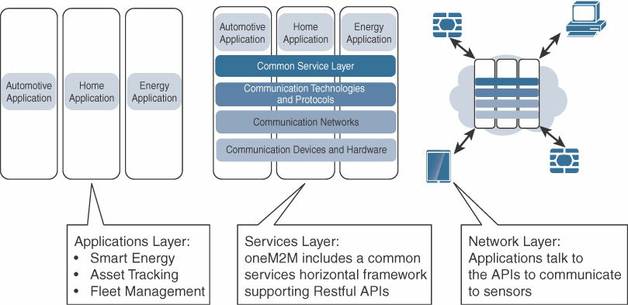
The Main Elements of the oneM2M IoT Architecture

Slide 50
Applications layer
The oneM2M architecture gives major attention to connectivity between devices and their applications.
This domain includes the application-layer protocols and attempts to standardize northbound API definitions for interaction with business intelligence (BI) systems.
Applications tend to be industry-specific and have their own sets of data models, and thus they are shown as vertical entities.

Slide 51
Services layer
Include the physical network that the IoT applications run on, the underlying management protocols, and the hardware
Adds APIs and middleware supporting third-party services and applications

Slide 52
Network layer
This is the communication domain for the IoT devices and endpoints.
It includes the devices themselves and the communications network that links them.
Embodiments of this communications infrastructure include wireless mesh technologies, such as IEEE 802.15.4, and wireless point-to-multipoint systems, such as IEEE 801.11ah.
Also included are wired device connections, such as IEEE 1901 power line communications.

Slide 53
The IoT World Forum (IoTWF) Standardized Architecture
In 2014 the IoTWF architectural committee (led by Cisco, IBM, Rockwell Automation, and others) published a seven-layer IoT architectural reference model.
Clean, simplified perspective on IoT and includes edge computing, data storage, and access

Slide 54
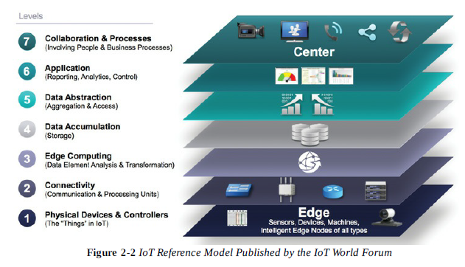
The IoT World Forum (IoTWF) Standardized Architecture

Slide 55
Defines a set of levels with control flowing from the center (this could be either a cloud service or a dedicated data center), to the edge, which includes sensors, devices, machines, and other types of intelligent end nodes.
In general, data travels up the stack, originating from the edge, and goes northbound to the center.

Slide 56
Decompose the IoT problem into smaller parts
Identify different technologies at each layer and how they relate to one another
Define a system in which different parts can be provided by different vendors
Have a process of defining interfaces that leads to interoperability
Define a tiered security model that is enforced at the transition points between levels

Slide 57
Layer 1: Physical Devices and Controllers Layer
This layer is home to the “things” in the Internet of Things, including the various endpoint devices and sensors that send and receive information.
The size of these “things” can range from almost microscopic sensors to giant machines in a factory.
Their primary function is generating data and being capable of being queried and/or controlled over a network.

Slide 58
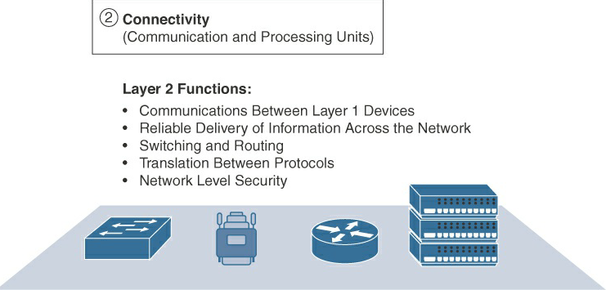
Layer 2: Connectivity Layer
Reliable and timely transmission of data.
This includes transmissions between Layer 1 devices and the network and between the network and information processing that occurs at Layer 3 (the edge computing layer).

Slide 59
Layer 3: Edge Computing Layer
The emphasis is on data reduction and converting network data flows into information that is ready for storage and processing by higher layers.
Information processing is initiated as early and as close to the edge of the network as possible

Slide 60
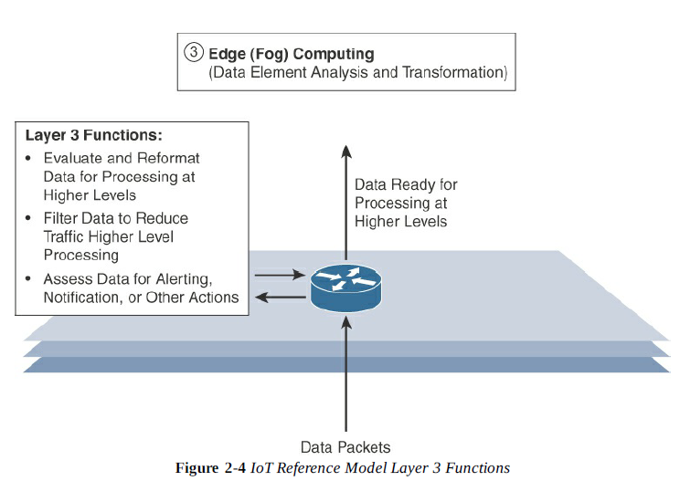

Slide 61
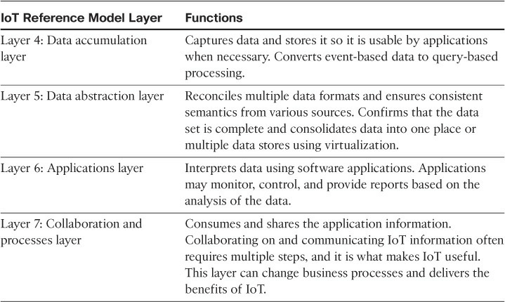
Upper Layers: Layers 4–7
The upper layers deal with handling and processing the IoT data generated by the bottom layer.

Slide 62
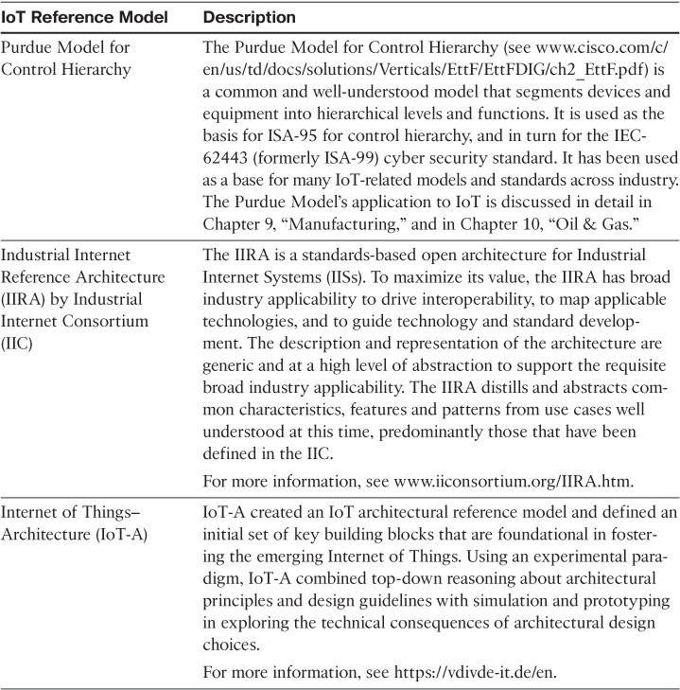
Alternative IoT models

Slide 63
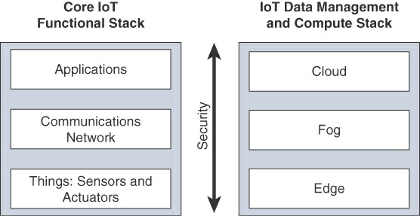
A Simplified IoT Architecture
An IoT framework that highlights the fundamental building blocks that are common to most IoT systems and which is intended to help you in designing an IoT network.
Presented as two parallel stacks.

Slide 64
Fog Computing
To distribute data management throughout the IoT system, as close to the edge of the IP network as possible.
The best-known. embodiment of edge services in IoT is fog computing. Any device with computing, storage, and network connectivity can be a fog node. Examples include industrial controllers, switches, routers, embedded servers, and IoT gateways.
Analyzing IoT data close to where it is collected minimizes latency, offloads gigabytes of network traffic from the core network, and keeps sensitive data inside the local network.

Slide 65
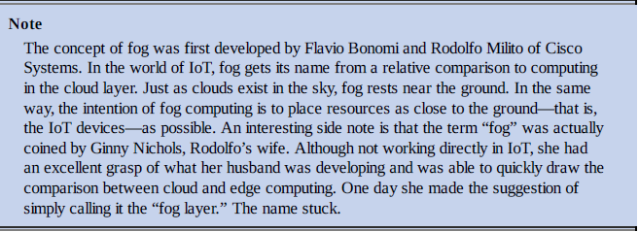
An advantage of this structure is that the fog node allows intelligence gathering (such as analytics) and control from the closest possible point, and in doing so, it allows better performance over constrained networks.

Slide 66
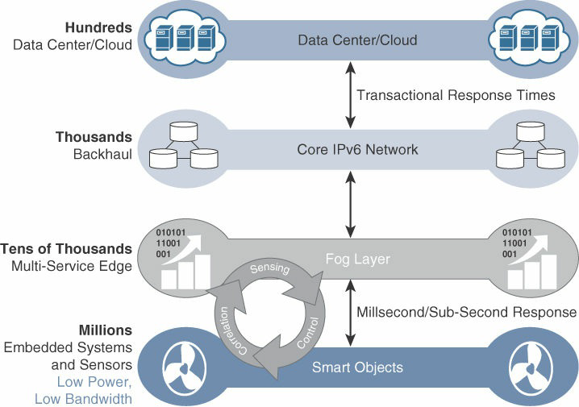

Slide 67
Edge Computing
The natural place for a fog node is in the network device that sits closest to the IoT endpoints, and these nodes are typically spread throughout an IoT network.
However, in recent years, the concept of IoT computing has been pushed even further to the edge, and in some cases it now resides directly in the sensors and IoT devices.

Slide 68
Edge computing is also sometimes called “mist” computing.
If clouds exist in the sky, and fog sits near the ground, then mist is what actually sits on the ground.
Thus, the concept of mist is to extend fog to the furthest point possible, right into the IoT endpoint device itself.

Slide 69
IoT devices and sensors often have constrained resources, however, as compute capabilities increase.
Some new classes of IoT endpoints have enough compute capabilities to perform at least low-level analytics and filtering to make basic decisions.

Slide 70
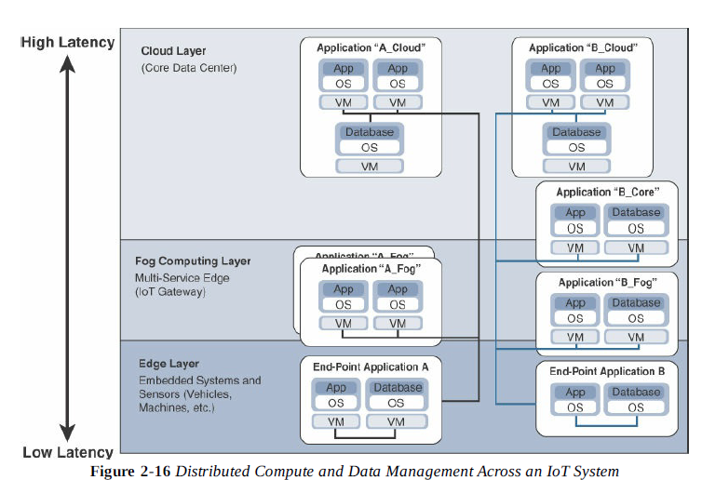

Slide 71
Sensors, Actuators, and Smart Objects
Sensors:
A sensor does exactly as its name indicates: It senses.
More specifically, a sensor measures some physical quantity and converts that measurement reading into a digital representation.
That digital representation is typically passed to another device for transformation into useful data that can be consumed by intelligent devices or humans.

Slide 72
Types
Active or passive: Sensors can be categorized based on whether they produce an energy output and typically require an external power supply (active) or whether they simply receive energy and typically require no external power supply (passive).
Invasive or non-invasive: Sensors can be categorized based on whether a sensor is part of the environment it is measuring (invasive) or external to it (non-invasive).
Contact or no-contact: Sensors can be categorized based on whether they require physical contact with what they are measuring (contact) or not (no-contact).
Absolute or relative: Sensors can be categorized based on whether they measure on an absolute scale (absolute) or based on a difference with a fixed or variable reference value (relative).
Area of application: Sensors can be categorized based on the specific industry or vertical where they are being used.
How sensors measure: Sensors can be categorized based on the physical mechanism used to measure sensory input (for example, thermoelectric, electrochemical, piezoresistive, optic, electric, fluid mechanic, photoelastic).
What sensors measure: Sensors can be categorized based on their applications or what physical variables they measure.

Slide 73


Slide 74


