Slide 1

CS8081
INTERNET OF THINGS

Slide 2
INTERNET OF THINGS
UNIT III
DESIGN AND DEVELOPMENT
Design Methodology - Embedded computing logic - Microcontroller, System on Chips - IoT system building blocks - Arduino - Board details, IDE programming - Raspberry Pi - Interfaces and Raspberry Pi with Python Programming

Slide 3
IoT Design Methodology that includes:
Purpose & Requirements Specification
Process Specification
Domain Model Specification
Information Model Specification
Service Specifications
IoT Level Specification
Functional View Specification
Operational View Specification
Device & Component Integration
Application Development

Slide 4
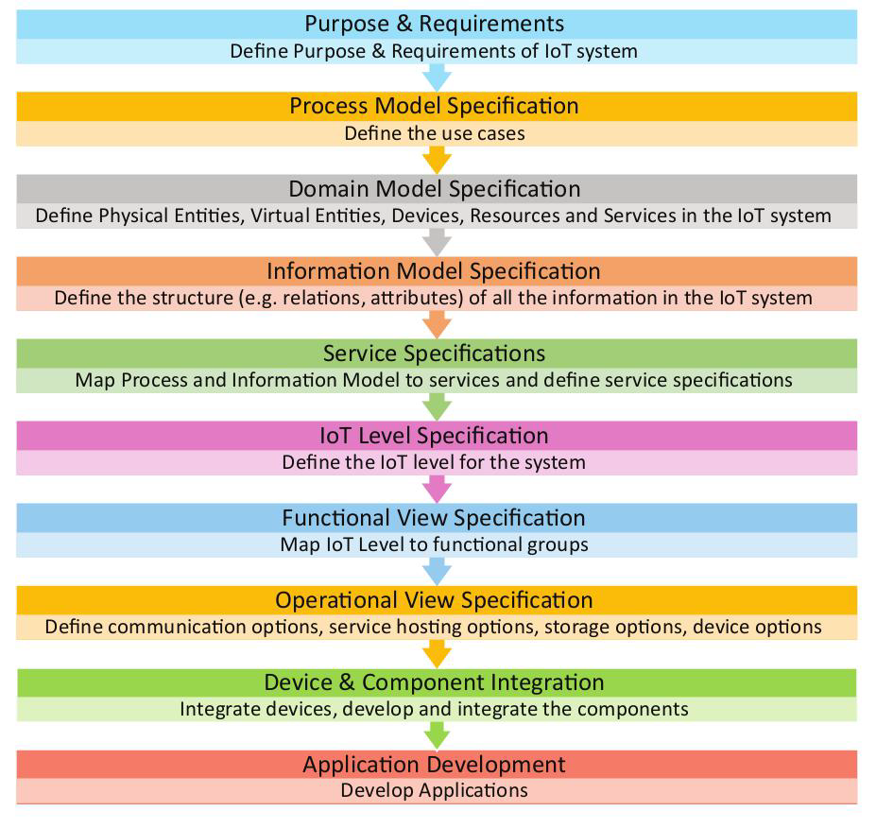
Design Methodology

Slide 5
Step 1: Purpose & Requirements Specification
The first step in IoT system design methodology is to define the purpose and requirements of the system.
In this step, the system purpose, behavior and requirements (such as data collection requirements, data analysis requirements, system management requirements, data privacy and security requirements, user interface requirements, ...) are captured.

Slide 6
Home Automation Case Study

Slide 7
Step:1 - Purpose & Requirements
Applying this to our example of a smart home automation system, the purpose and requirements for the system may be described as follows:
Purpose : A home automation system that allows controlling of the lights in a home remotely using a web application.
Behavior : The home automation system should have auto and manual modes. In auto mode, the system measures the light level in the room and switches on the light when it gets dark. In manual mode, the system provides the option of manually and remotely switching on/off the light.
System Management Requirement : The system should provide remote monitoring and control functions.
Data Analysis Requirement : The system should perform local analysis of the data.
Application Deployment Requirement : The application should be deployed locally on the device, but should be accessible remotely.
Security Requirement : The system should have basic user authentication capability.

Slide 8
Step 2: Process Specification
The second step in the IoT design methodology is to define the process specification.
In this step, the use cases of the IoT system are formally described based on and derived from the purpose and requirement specifications.

Slide 9
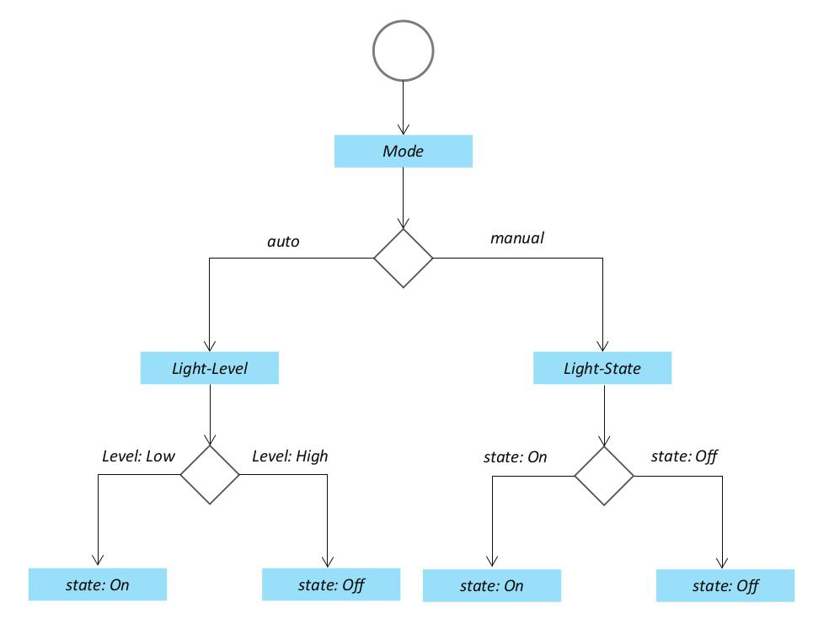

Slide 10
3. Domain Model Specification
The domain model describes the main concepts, entities and objects in the domain of IoT system to be designed.
Domain model defines the attributes of the objects and relationships between objects.
Domain model provides an abstract representation of the concepts, objects and entities in the IoT domain, independent of any specific technology or platform.
With the domain model, the IoT system designers can get an understanding of the IoT domain for which the system is to be designed.
(Physical Entity, Virtual Entity, Device, Resource, Service)

Slide 11
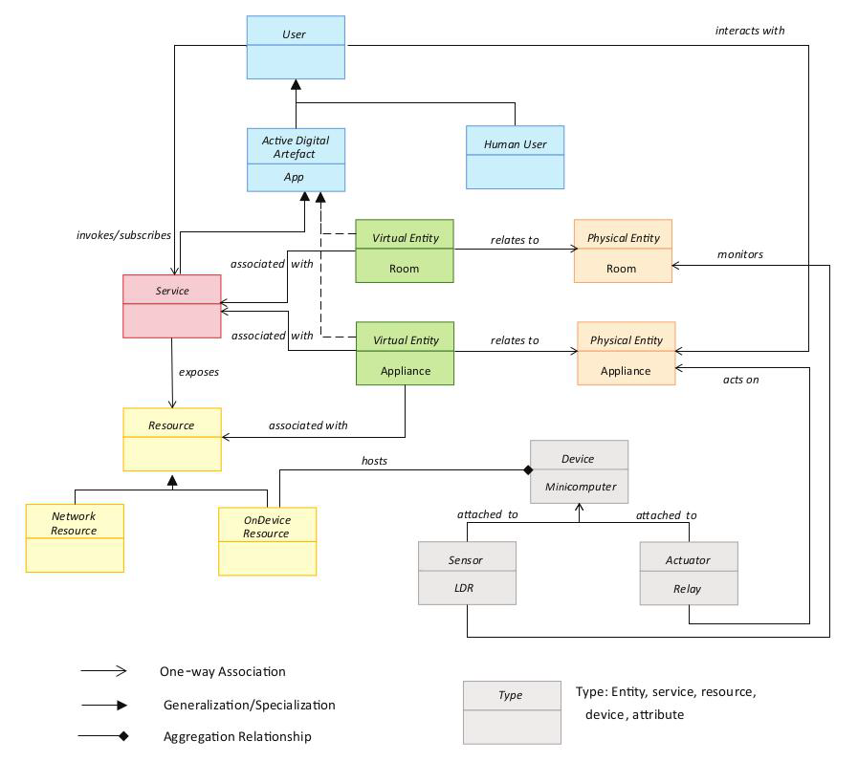

Slide 12
4. Information Model Specification
Information Model defines the structure of all the information in the IoT system, for example, attributes of Virtual Entities, relations, etc.
Information model does not describe the specifics of how the information is represented or stored.
To define the information model, we first list the Virtual Entities defined in the Domain Model.
Information model adds more details to the Virtual Entities by defining their attributes and relations.

Slide 13
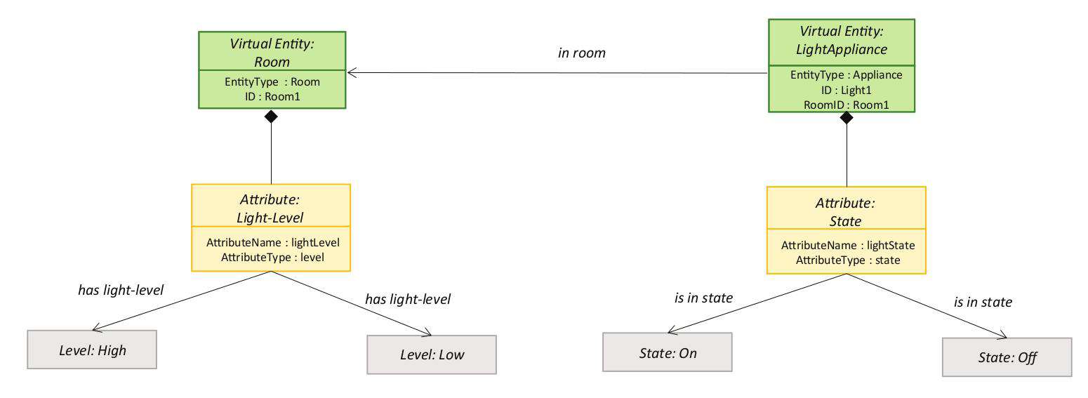

Slide 14
5. Service Specifications
Service specifications define the services in the IoT system, service types, service inputs/output, service endpoints, service schedules, service preconditions and service effects.

Slide 15
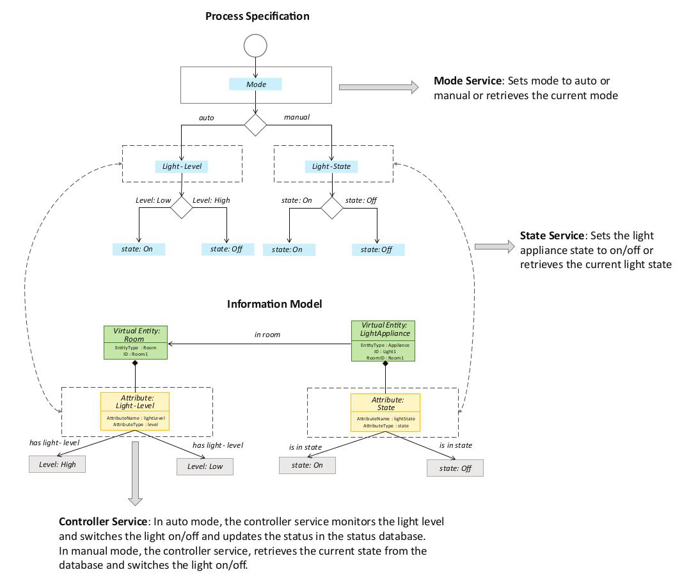

Slide 16
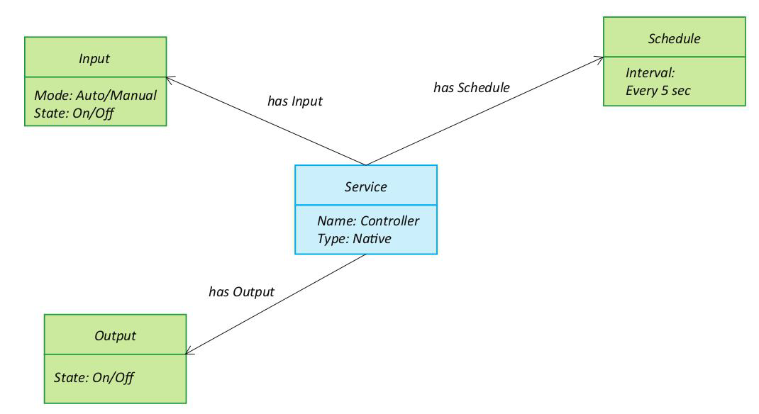

Slide 17
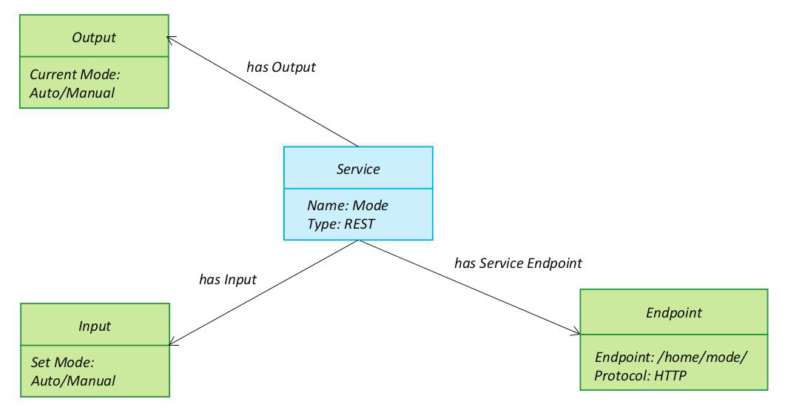

Slide 18
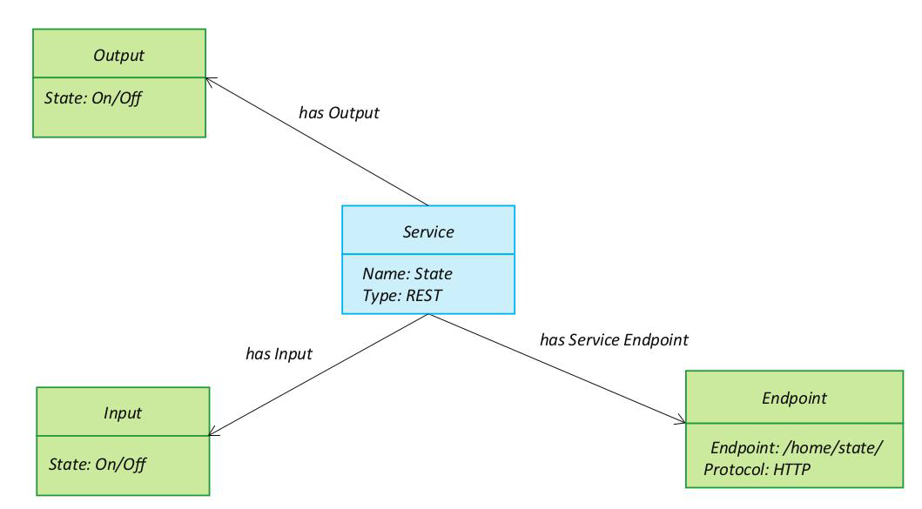

Slide 19
6. IoT Level Specification
The sixth step in the IoT design methodology is to define the IoT level for the system.
Five IoT deployment levels.

Slide 20
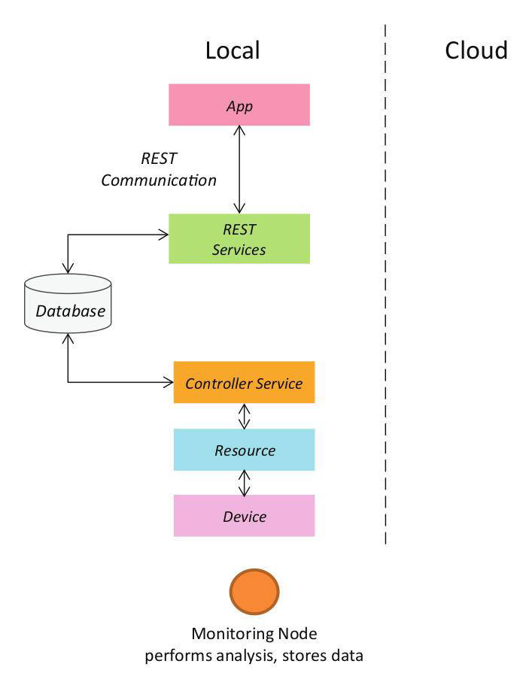

Slide 21
7. Functional View Specification
The Functional View (FV) defines the functions of the IoT systems grouped into various Functional Groups (FGs).
Functional Group either provides functionalities for interacting with instances of concepts defined in the Domain Model or provides information related to these concepts.

Slide 22
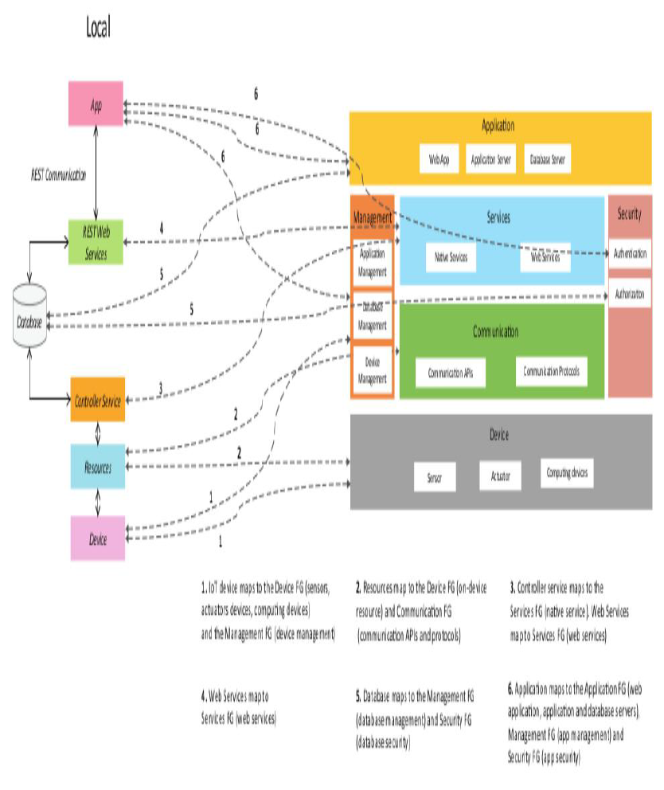

Slide 23
8.Operational View Specification
In this step, various options pertaining to the IoT system deployment and operation are defined, such as, service hosting options, storage options, device options, application hosting options, etc

Slide 24
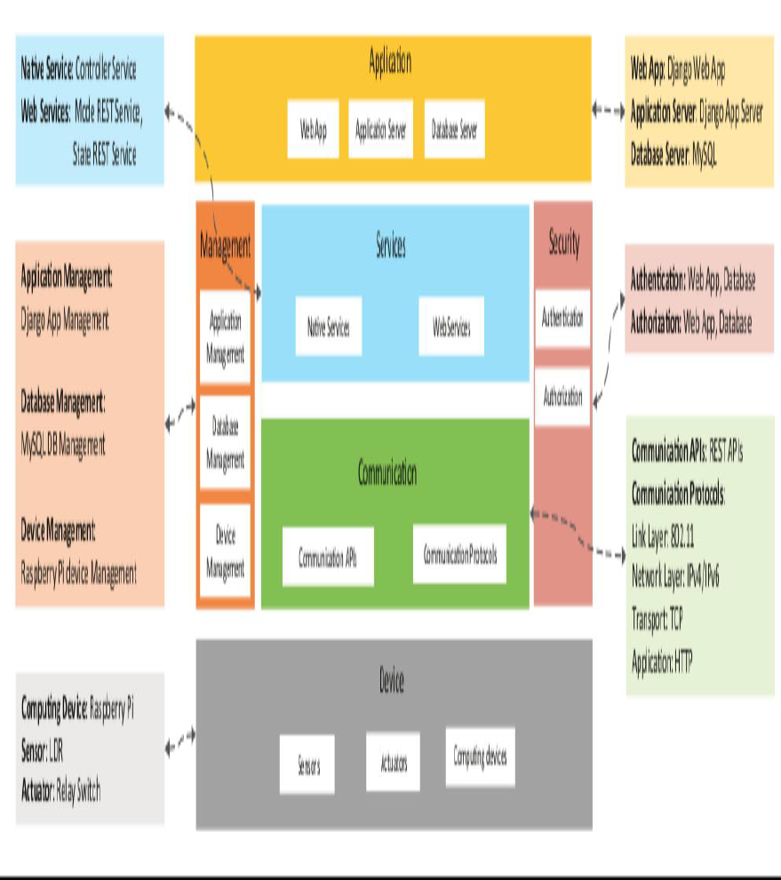

Slide 25
9. Device & Component Integration
The ninth step in the IoT design methodology is the integration of the devices and components.
Step 10: Application Development
  The final step in the IoT design methodology is to develop the IoT application

Slide 26
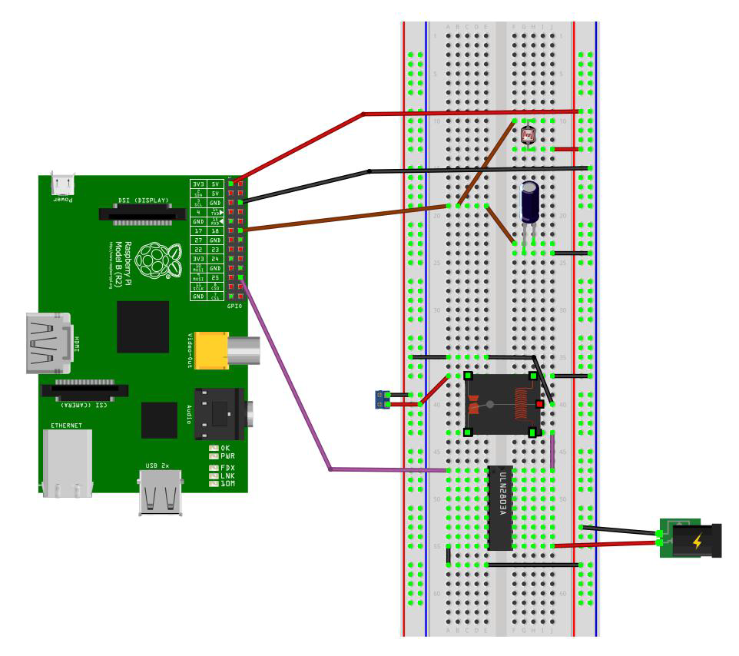

Slide 27
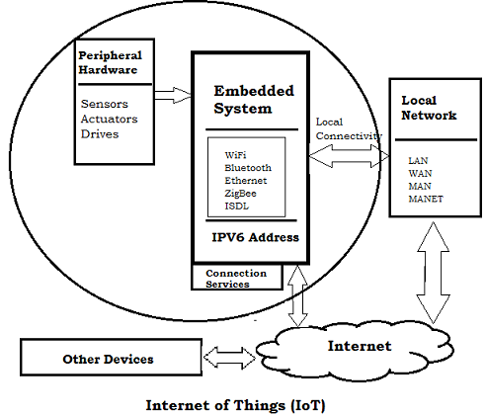
Embedded Computing Logic
The embedded devices are the objects that build the unique computing system.

Slide 28
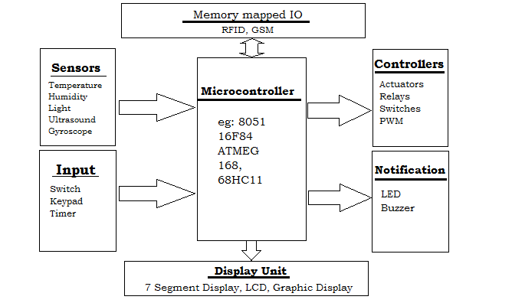
Embedded System Hardware

Slide 29
Embedded System Software
The embedded system that uses the devices for the operating system is based on the language platform, mainly where the real-time operation would be performed.
Manufacturers build embedded software in electronics, e.g., cars, telephones, modems, appliances, etc.
The embedded system software can be as simple as lighting controls running using an 8-bit microcontroller.
It can also be complicated software for missiles, process control systems, airplanes etc.

Slide 30
Microcontrollers for Embedded Computing with IoT Devices
The microcontroller specifications that determine the best part for your application are:
Bit depth: The register and data path width impacts the speed and accuracy with which microcontrollers can perform non-trivial computations.
Memory: The amount of RAM and Flash in a microcontroller determines the code size and complexity the component can support at full speed. Large memories have larger die area and component cost.

Slide 31
GPIO: These are the microcontroller pins used to connect to sensors and actuators in the system. These often share their functionality with other microcontroller peripherals, such as serial communication, A/D, and D/A converters.
Power consumption: Power consumption is critically important for battery-operated devices and it typically increases with microcontroller speed and memory size.

Slide 32
System on Chips
System on Chip in IoT designed by Redpine Signals is discussed below.
This IoT SoC supports
  WLAN,
  bluetooth and
  Zigbee systems on a single chip.
  It also supports 2.4 and 5GHz radio frequencies.

Slide 33
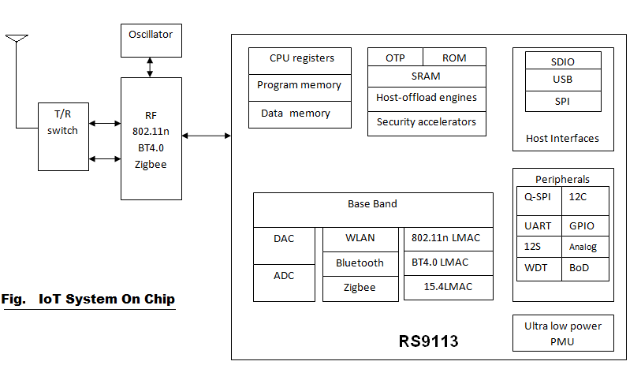

Slide 34
Typical IoT system on chip support more than one RATs (Radio Access Technologies) It will have following modules
Transmit and receive switch.
RF part mainly consists of Transmitter, receiver, oscillator and amplifiers.
Memories i.e. Program memory, data memory to store the code and data
Physical layer(baseband processing) either on FPGA or on processor based on complexity and latency requirement.
MAC layer and upper protocol stacks TCP/IP etc. running on processor
ADC and DAC to provide interface between digital baseband and analog RF portions.
Various interfaces such as SDIO, USB, SPI etc to provide interface with the host.
Other peripherals such as UART, I2C, GPIO, WDT etc. to use the IoT SoC for various connections.

Slide 35
This IoT SoC (system on chip in IoT) can be used for numerous applications as mentioned below:
• Mobile
• M2M-Communication
• Real time location finding tags
• Thermostats
• Smart meters
• Wireless sensor devices
• Serial to WiFi converter
• Voice Over WiFi compliant phones
• Home automation
• Health care devices and equipments

Slide 36
Building Blocks Of IoT
Sensing
Sensors can be either on-board the IoT device or attached to the device.
Actuation
IoT devices can have various types of actuators attached that allow taking actions upon the physical entities in the vicinity of the device.
Communication
Communication modules are responsible for sending collected data to other devices or cloud-based servers/storage and receiving data from other devices and commands from remote applications.
Analysis & Processing
Analysis and processing modules are responsible for making sense of the collected data.

Slide 37
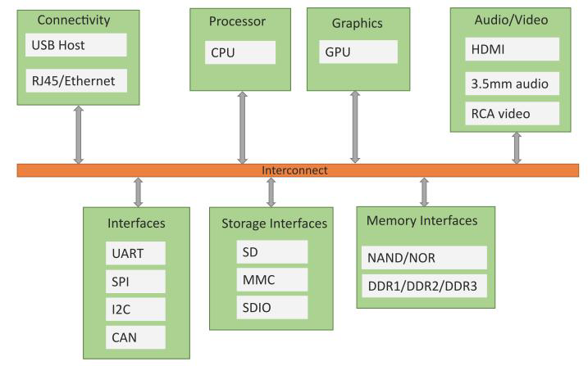

Slide 38
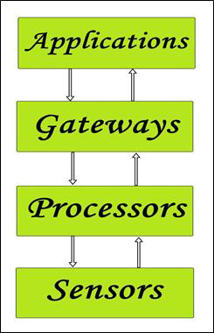
Simplified block diagram of the basic building blocks of the IoT

Slide 39
Gateways
Gateways are responsible for routing the processed data and send it to proper locations for its (data) proper utilization.
Gateway helps in to and fro communication of the data. It provides network connectivity to the data.
Network connectivity is essential for any IoT system to communicate.
LAN, WAN, PAN, etc are examples of network gateways.

Slide 40
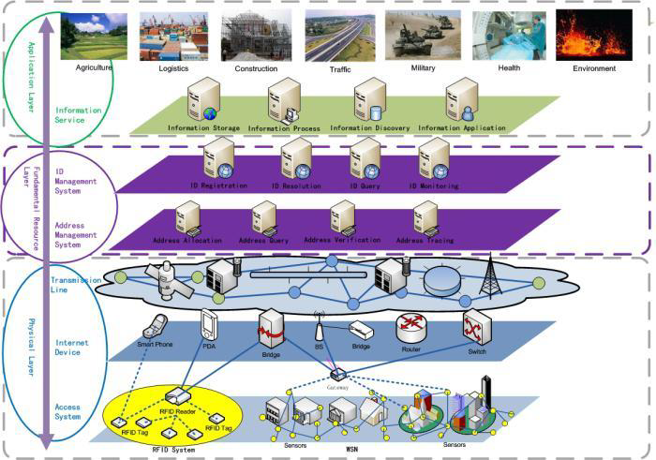
IoT Architecture Layers

Slide 41
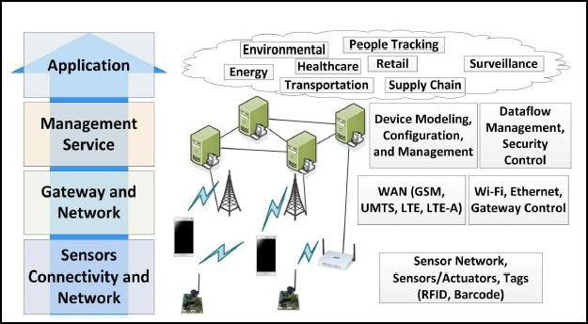

Slide 42
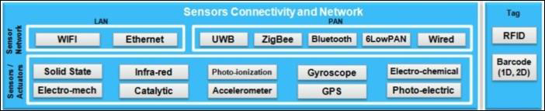
Sensor, Connectivity and Network Layer

Slide 43
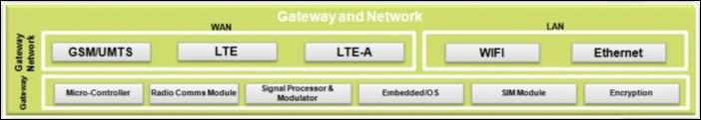
Gateway and Network Layer
Responsible for routing the data coming from the Sensor, Connectivity and Network layer and pass it to the next layer which is the Management Service Layer.

Slide 44
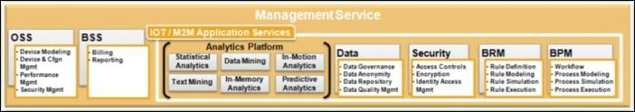
Management Service Layer
For managing IoT services.
Responsible for data mining, text mining, service analytics, etc .
Data management, Device Management

Slide 45

Application Layer
Application layer forms the topmost layer of IoT architecture which is responsible for effective utilization of the data collected.

Slide 46
Arduino boards
Arduino boards based on ATMEGA328 microcontroller
Programed through the Arduino IDE.

Slide 47
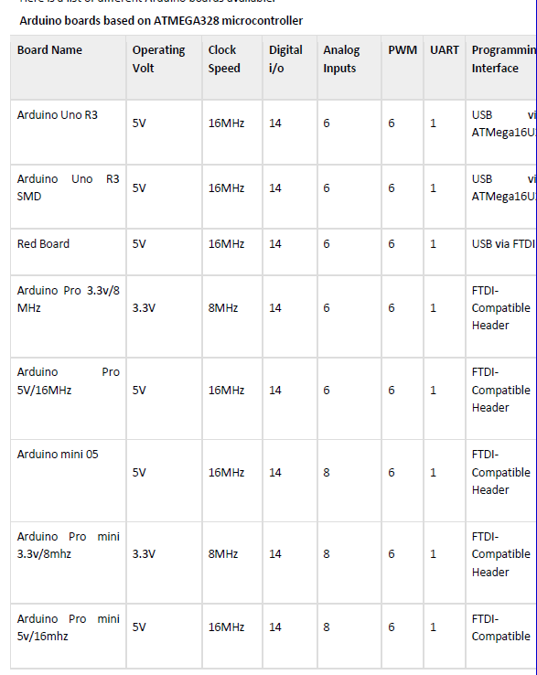

Slide 48
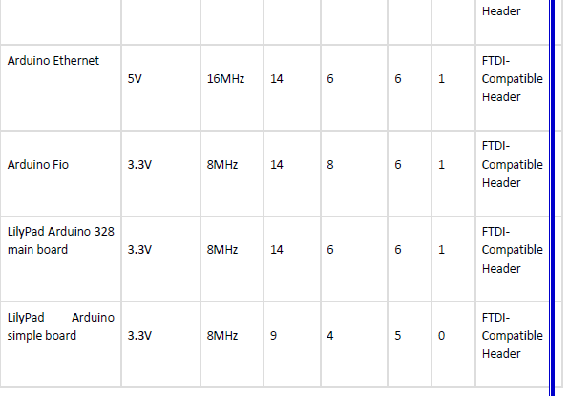

Slide 49
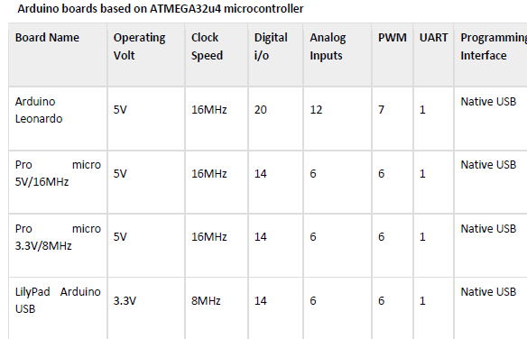

Slide 50
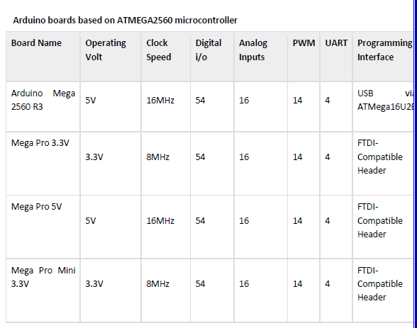

Slide 51
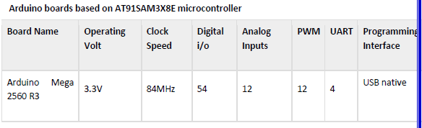

Slide 52
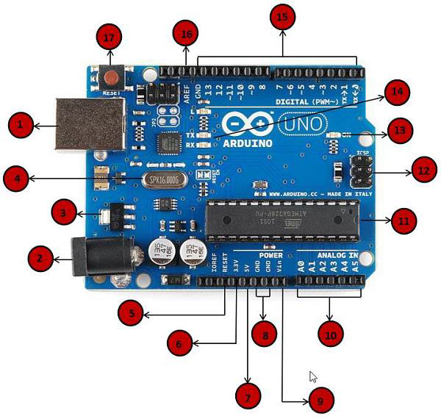
Arduino UNO board

Slide 53
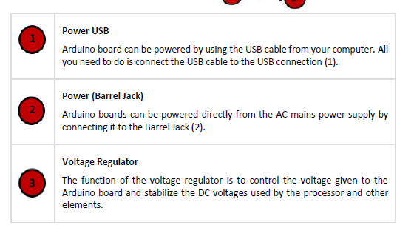

Slide 54
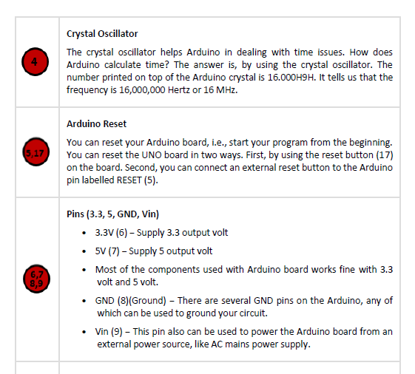

Slide 55
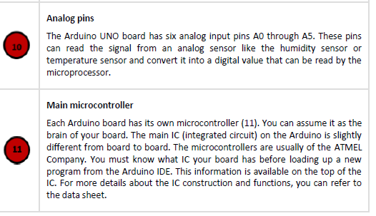

Slide 56
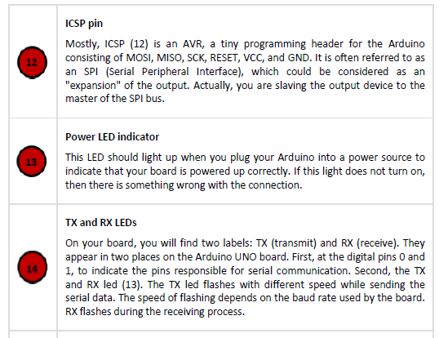

Slide 57
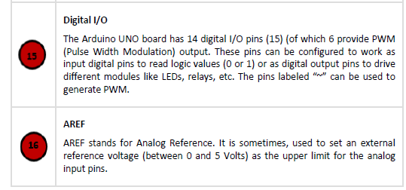

Slide 58
Arduino IDE
After learning about the main parts of the Arduino UNO board, we are ready to learn how to set up the Arduino IDE.
Once we learn this, we will be ready to upload our program on the Arduino board.

Slide 59
Set up the Arduino IDE on our computer and prepare the board to receive the program via USB cable.
Step 1 − First you must have your Arduino board (you can choose your favorite board) and a USB cable.
In case you use Arduino UNO, Arduino Duemilanove, Nano, Arduino Mega 2560, or Diecimila, you will need a standard USB cable (A plug to B plug), the kind you would connect to a USB printer as shown in the following image.

Slide 60
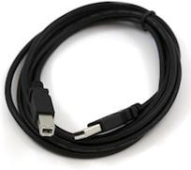
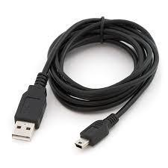
In case you use Arduino Nano, you will need an A to Mini-B cable instead as shown in the following image.

Slide 61
Step 2 − Download Arduino IDE Software.
You can get different versions of Arduino IDE from the Download page on the Arduino Official website.
You must select your software, which is compatible with your operating system (Windows, IOS, or Linux).
After your file download is complete, unzip the file.

Slide 62
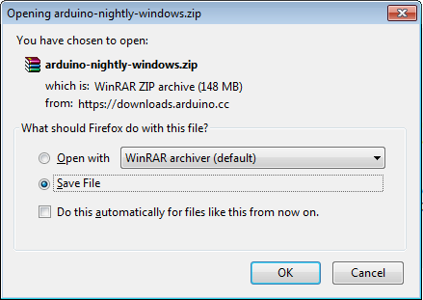

Slide 63
Step 3 − Power up your board.
The Arduino Uno, Mega, Duemilanove and Arduino Nano automatically draw power from either, the USB connection to the computer or an external power supply.
If you are using an Arduino Diecimila, you have to make sure that the board is configured to draw power from the USB connection.
The power source is selected with a jumper, a small piece of plastic that fits onto two of the three pins between the USB and power jacks.
Check that it is on the two pins closest to the USB port.
Connect the Arduino board to your computer using the USB cable. The green power LED (labeled PWR) should glow.

Slide 64
Step 4 − Launch Arduino IDE.
After your Arduino IDE software is downloaded, you need to unzip the folder.
Inside the folder, you can find the application icon with an infinity label (application.exe). Double-click the icon to start the IDE.

Slide 65
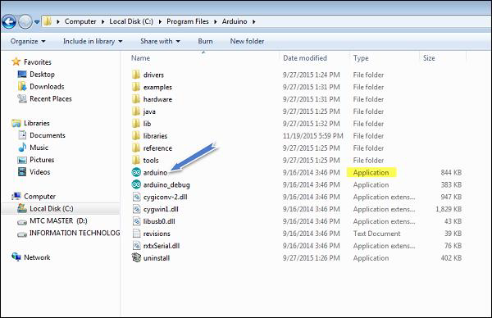

Slide 66
Step 5 − Open your first project.
Once the software starts, you have two options −
• Create a new project.
• Open an existing project example.
To create a new project, select File → New.

Slide 67
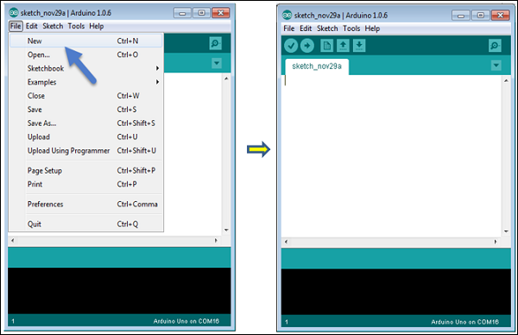

Slide 68
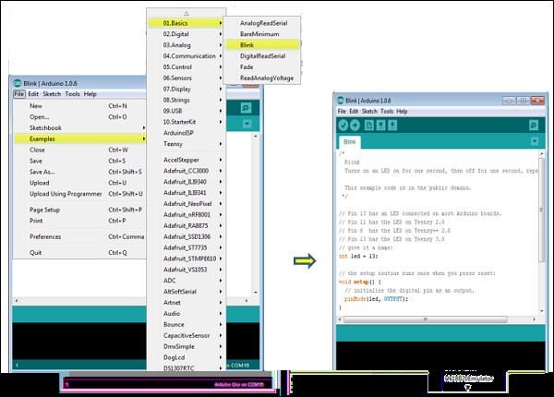
To open an existing project example, select File → Example → Basics → Blink.

Slide 69
LED on and off
Here, we are selecting just one of the examples with the name Blink.
It turns the LED on and off with some time delay.
You can select any other example from the list.

Slide 70
Step 6 − Select your Arduino board.
To avoid any error while uploading your program to the board, you must select the correct Arduino board name, which matches with the board connected to your computer.
Go to Tools → Board and select your board.

Slide 71
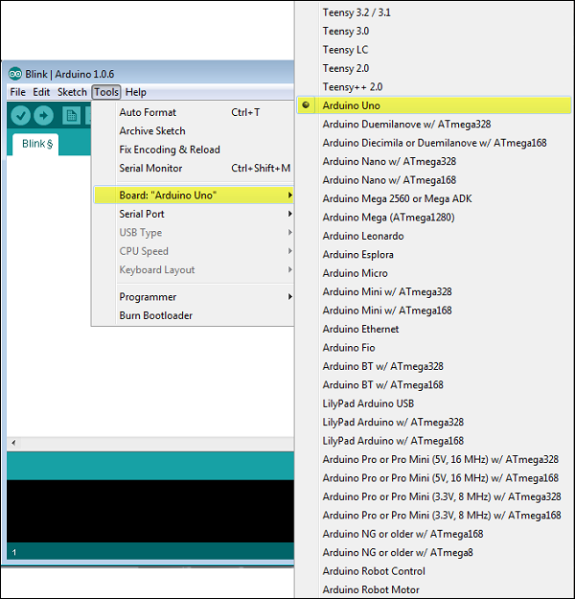

Slide 72
Step 7 − Select your serial port.
Select the serial device of the Arduino board. Go to Tools → Serial Port menu.
This is likely to be COM3 or higher (COM1 and COM2 are usually reserved for hardware serial ports).
To find out, you can disconnect your Arduino board and re-open the menu, the entry that disappears should be of the Arduino board.
Reconnect the board and select that serial port.

Slide 73
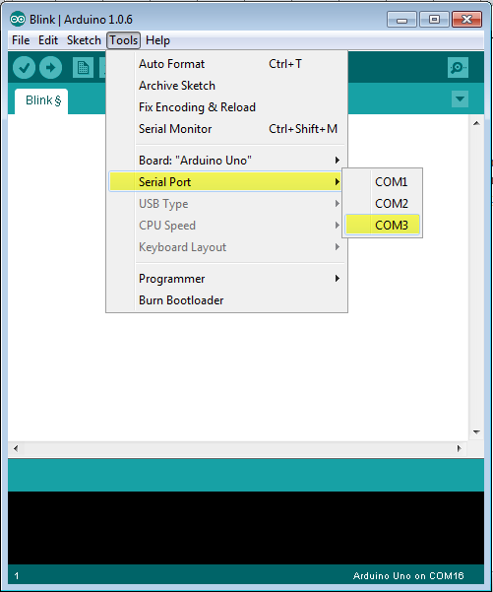

Slide 74
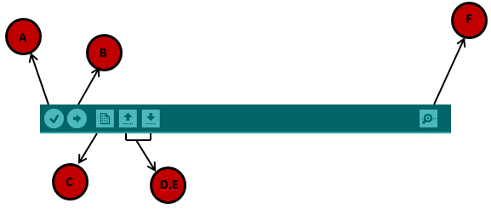
Symbols appearing in the Arduino IDE toolbar.

Slide 75
A − Used to check if there is any compilation error.
B − Used to upload a program to the Arduino board.
C − Shortcut used to create a new sketch.
D − Used to directly open one of the example sketch.
E − Used to save your sketch.
F − Serial monitor used to receive serial data from the board and send the serial data to the board.

Slide 76
Step 8 − Upload the program to your board.
Simply click the "Upload" button in the environment.
Wait a few seconds; you will see the RX and TX LEDs on the board, flashing.

Slide 77
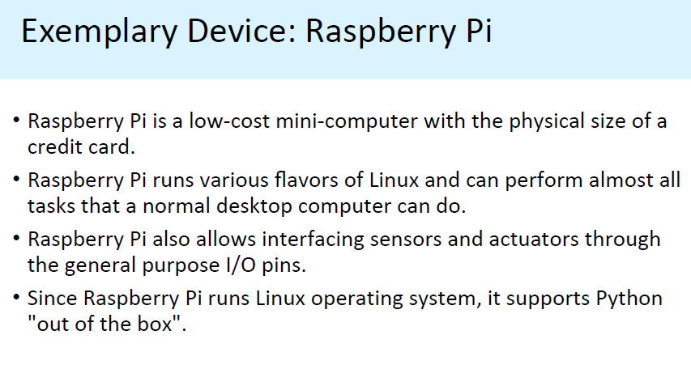

Slide 78
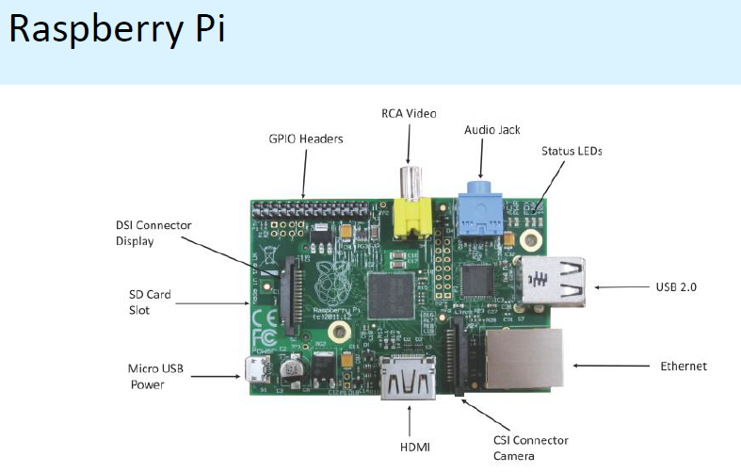

Slide 79
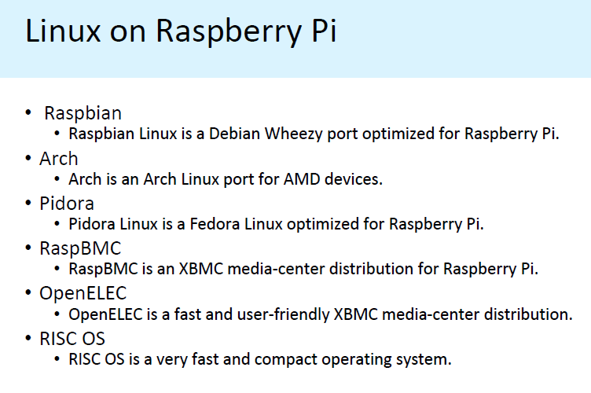

Slide 80
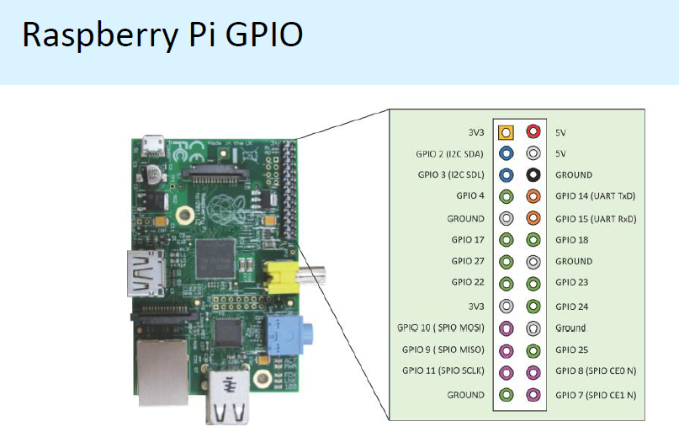

Slide 81
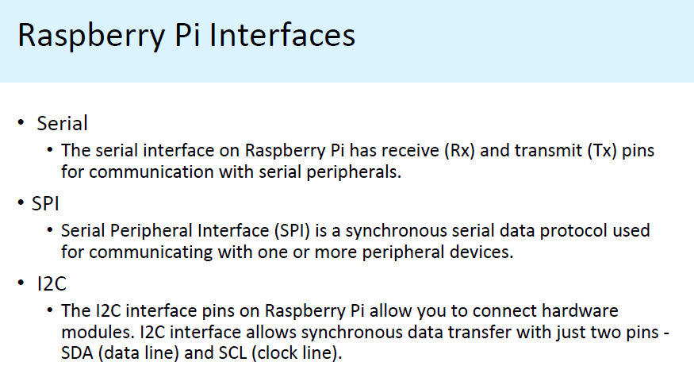

Slide 82
